Slide 1

Providing families with
Care Management, Home Care Services, Advocacy, Counseling, Support Groups and Education since 1989
Experts in Life Transitions, Partners in Caring
www.EldercareAnswers.com

Slide 2

PREPARING TO BE A FAMILY CAREGIVER:
WHAT YOU AND YOUR CLIENTS NEED TO KNOW
Linda Fodrini-Johnson, MA, MFT, CMC
Founder and Executive Director
Chief Professional Officer, VillagePlan

Slide 3


GOALS
Become sensitive to the emotional journey of caregiving
Learn how to have challenging conversations
Review of necessary documents for caregivers
Importance of values & wishes in documents
Highlight the importance of Self-Care on Health
Become aware of the value of “Mindfulness” in caregiving & health
www.EldercareAnswers.com

Slide 4

GROUP EXERCISE
Count off by 3’s and turn into that small group
I want you to hold on to your first reaction to the situation I am going to ask you to imagine
www.EldercareAnswers.com

Slide 5

YOUR PARTNER HAS A DIAGNOSIS . . .
Cancer
Alzheimer’s
Stroke
www.EldercareAnswers.com

Slide 6
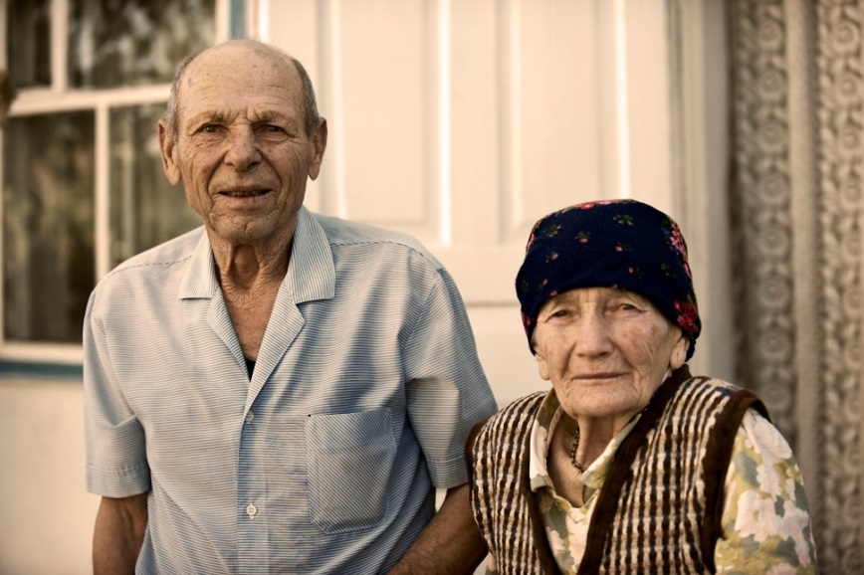
DAD HAD A STROKE – MOM HAS DEMENTIA: NOW WHAT?
Where do I start?
What do they need?
How can you work, have a family and help?
Do they or you have the financial resources needed?
Do you need to change your life?
www.EldercareAnswers.com

Slide 7

WHAT HAPPENS FIRST . . .
Can’t hear anything but that diagnosis – zaps the joy right out of your life
Denial, fear, other?
Consumed with wanting answers
Unsure about your future
www.EldercareAnswers.com

Slide 8

EMOTIONAL BALANCE
Before you can seek expertise, you or your client need to feel heard and validated for whatever feelings the client holds
www.EldercareAnswers.com

Slide 9

COUNSELING / COACHING / PLANNING
When emotions are raw, very little planning can happen
Your client or your family might need to first meet with a therapist or professional care manager
Once you can name and hold on to the feelings, you can begin to move on…
www.EldercareAnswers.com

Slide 10

WHAT TYPE OF SUPPORT MIGHT BE NEEDED?
Information on the illness
Referrals for planning for the future
Knowledge about entitlements
Emotional Support – the pain is different for everyone
Extended Family Support – there can be family conflict
www.EldercareAnswers.com

Slide 11

A NEW DIAGNOSIS FOR A CLIENT
What did the patient hear?
What did the family member hear?
Did you wait for their response before referring out? Listening with intention
Can you at first just stay with the feeling?
Do you have a handout about first steps to take?
www.EldercareAnswers.com

Slide 12

INSTILLING HOPE
Depending on what the trajectory is for this illness - can you help with the following?
Hope
Being in the Moment
Can you find time to be with each individual alone and together?
The caregiver will be your partner, but caregivers have needs too – be sure to address self-care!
www.EldercareAnswers.com

Slide 13
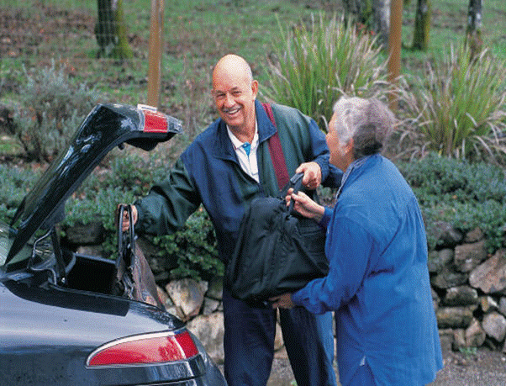
WHO IS PROVIDING CARE TO AGING FAMILY MEMBERS? YOU!
43.5 million care for an adult who is ill or disabled
34.2 million care for someone over 50
15.7 million care for someone with a dementia
60% of family caregivers are still in the workforce
78% of all care is provided by families and 46% of them are performing nursing tasks
www.EldercareAnswers.com

Slide 14
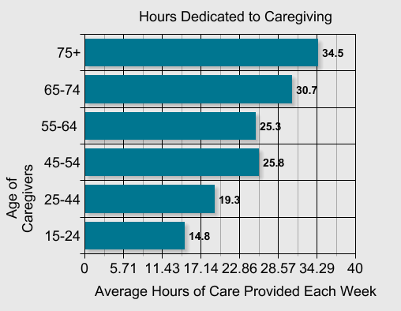

AGE OF CAREGIVERS
Family Caregiver Alliance – www.Caregiver.org
www.EldercareAnswers.com

Slide 15
PLANNING TO BE A CAREGIVER
Medical & Mental Health Issues | Financial Issues
Legal Issues | Communicating
www.EldercareAnswers.com

Slide 16

WHAT DO YOU NEED TO BE AWARE OF TO BE PREPARED FOR HEALTH ISSUES?
Health Information
Documents
Medical Providers
Medications
Allergies
Insurances
Health History
DPOA for Healthcare
“Advanced Health Care Directives”
POLST – Physicians Orders for Life Sustaining
Treatments
www.EldercareAnswers.com

Slide 17

HOW DO YOU HELP WITH
FINANCES – LEGAL TOOLS?
Durable Power of Attorney for Finances
  Regular
  Short Term
  Springing
Where does income come from & where is it deposited?
Is there LTC Insurance?
Trustee of Trust
Conservator or Guardian
  Estate
  Person
Joint Accounts (can be a problem)
Special Needs Trustee
www.EldercareAnswers.com

Slide 18

ENTITLEMENTS
Social Security
Medicare
VA Benefits
SSI/SDI
Medi-Cal
IHSS
HUD Housing
Local Non-profits
Where to look or call to see what we/they qualify for?
BenefitsCheckup.org
1-800-510-2020
Senior Information
www.EldercareAnswers.com

Slide 19

COMMUNICATION
Importance of communicating values, wishes and desires
Holding Family Meetings
Be Prepared – location and timing is important!
www.EldercareAnswers.com

Slide 20
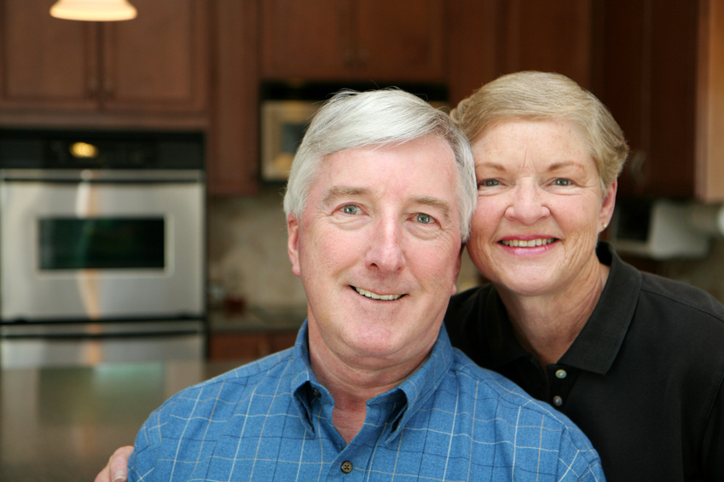
THE FRAMEWORK FOR A
CHALLENGING CONVERSATION
The invitation
Starting the conversation
Who should be there
Discussing your wishes and values
Discussing legal tools
Listening to concerns and fears
www.EldercareAnswers.com

Slide 21

COMMUNICATING
What if my loved one doesn’t agree with the plan I am proposing?
Remember to start with the “I” messages and not “should”
Introduce options for the “future” if possible
www.EldercareAnswers.com

Slide 22
WHEN THE HOME IS NOT SAFE AND
OTHERS NEED TO MAKE DECISIONS!
Judgment and capacity to self-care can be impaired due to a progressive illness like Alzheimer’s or a related disorder
You will need legal tools to intervene
A move might be the only option (not bad, just hard)
Work with a Certified Care Manager -Aging Life Care Professional™
EldercareAnswers.com
VillagePlan.com
AgingLifeCare.org
www.EldercareAnswers.com

Slide 23

BURDEN OF CAREGIVING ON HEALTH
Major illnesses have a stress related etiology
Cancer
Cardiac
Dementia
Inflammatory Illnesses
Mental Health Issues
Depression
Anxiety
Suicide Ideation
www.EldercareAnswers.com

Slide 24
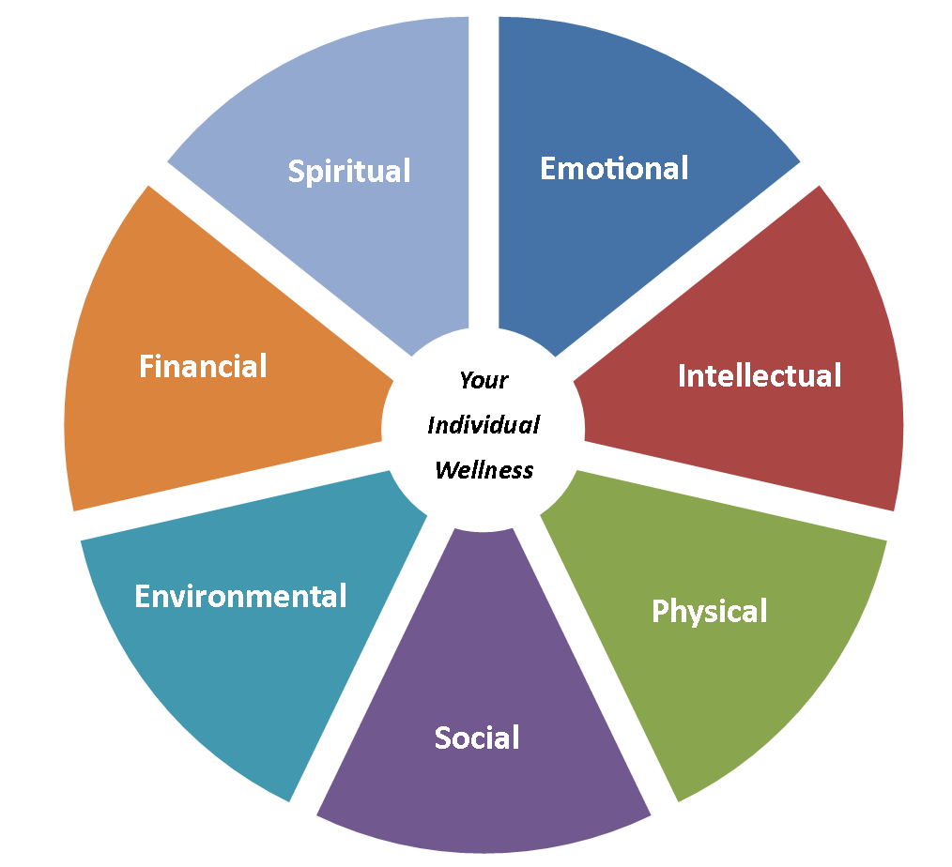
BALANCE
www.EldercareAnswers.com

Slide 25

STAY HEALTHY AS A CAREGIVER
Ask for Help – don’t do this alone!
Be specific!
Join a Support
Group
www.EldercareAnswers.com

Slide 26

HEALTHY CAREGIVER
Exercise daily
Eat a heart healthy diet
Stay engaged to activities that bring you joy and expand your mind
Use respite services – “share the care”
www.EldercareAnswers.com

Slide 27

MINDFULNESS
Do “mindfulness” exercises daily
Meditation
Yoga
Prayer
Breathe
Exercises
Nature walks
Moment
Focus
www.EldercareAnswers.com

Slide 28

www.EldercareAnswers.com

Slide 29
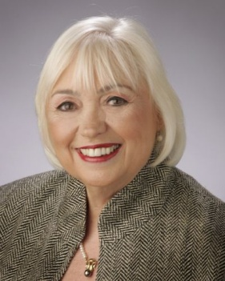

PRESENTER’S INFORMATION
Linda Fodrini-Johnson, MA, MFT, CMC
Founder & Executive Director
Eldercare Services – Since 1989 – 28 years serving the
SF Bay Area
Chief Professional Officer – www.VillagePlan.org
1808 Tice Valley Blvd., Walnut Creek, CA 94595
(925) 937-2018
Linda@EldercareAnswers.com or Linda@VillagePlan.com
www.EldercareAnswers.com
Eldercare Services provides advocacy, counseling, care management, home care (from 2 hours to 24 hours), concierge services, support groups, family education and has experts with many years of experience in assisting individuals make challenging decisions. VillagePlan connects to care managers everywhere.
www.EldercareAnswers.com

