Slide 1
How to Create LGBTQ-Inclusive Senior Care Facilities
Our Aging Nation
October 24, 2019

Slide 2
Objectives
1. Discern the differences between three dimensions of sexuality: sexual identity, sexual orientation, and sexual behavior.
2. Discern the differences between three dimensions of gender: gender biology, gender expression, and gender identity.
3. Learn definitions for various terms used to refer to LGBTQ+ people, including terms to avoid.
4. Practice asking others what their pronouns are, sharing their pronouns, and using gender-neutral pronouns.
5. Learn about health disparities that impact LGBTQ+ seniors as they access healthcare and senior service systems.
6. Learn about Title 22 LGBTQ training requirements for senior nursing facilities.

Slide 3
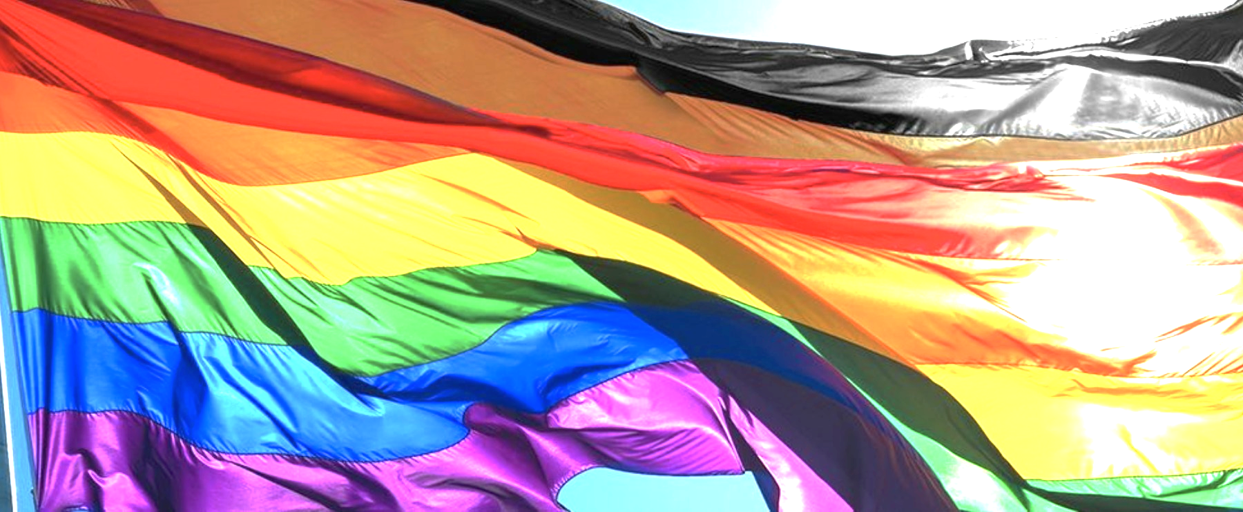
LGBTQ Terminology

Slide 4
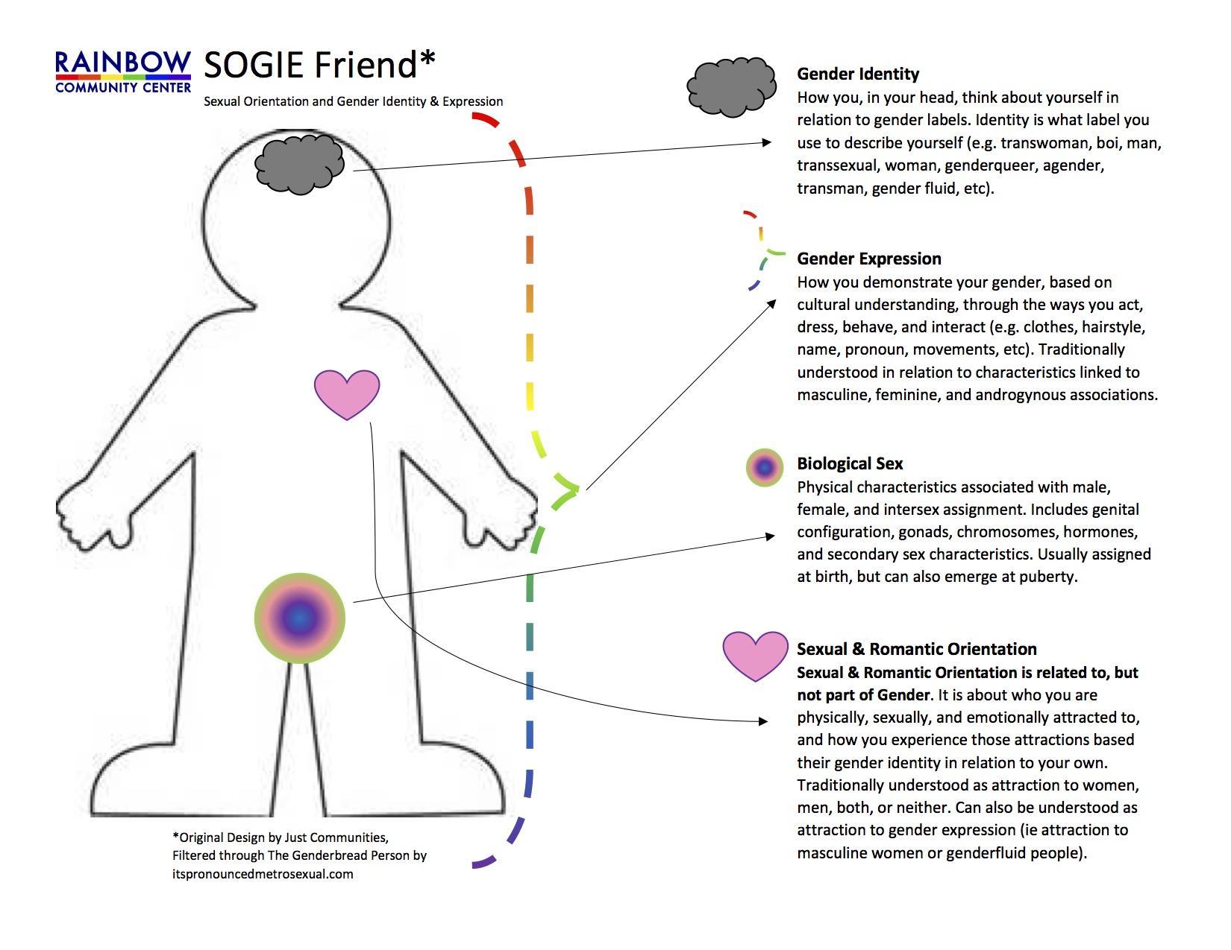
WHAT IS SOGIE?
Sexual Orientation, Gender Identity, gender Expression

Slide 5
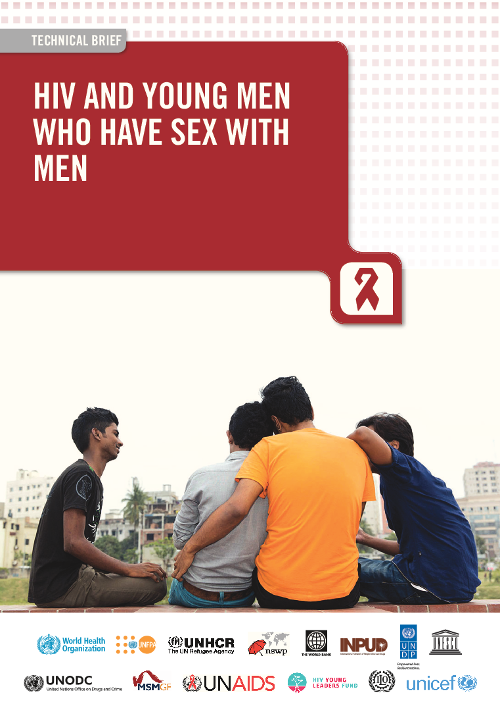
Three Dimensions of Sexuality
Sexual Orientation
Internal feelings related to sexuality (may or may not be expressed in behavior)
Sexual Behavior
External actions taken based on internal feelings of sexuality (e.g. situational choices made around sex, commercial exchanges)
Sexual Identity
Internal and external meaning attached to orientation, behaviors, and filtered through personal understanding of terms, and culture interpretations

Slide 6
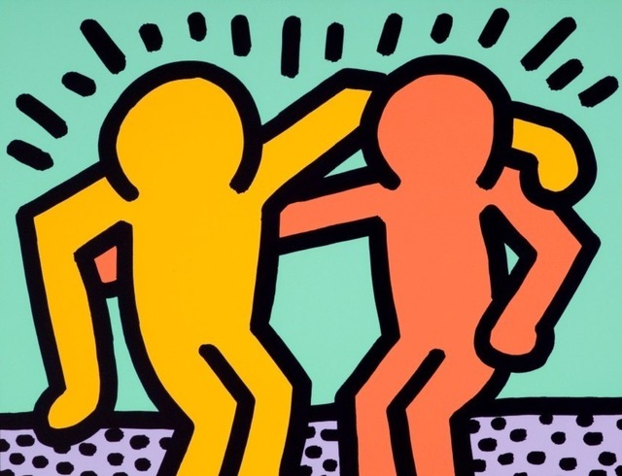
Sexuality
Have these dimensions of sexuality always been aligned in your life?
Have you witnessed or been part of someone’s coming out process?

Slide 7
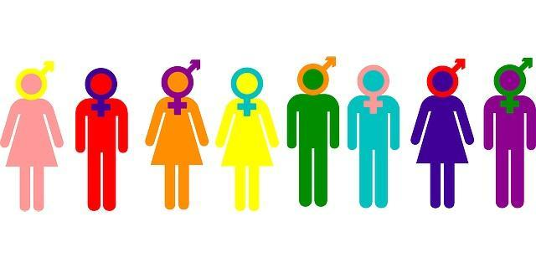
What is gender?
Biological sex
Gender expression
Gender identity

Slide 8
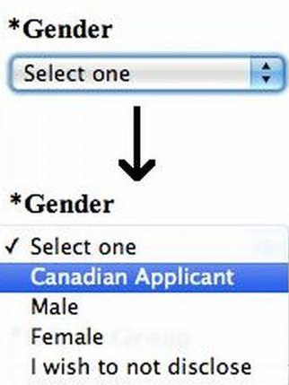
Biological Sex
Assigned at birth based on internal and external sex organs, chromosomes, and hormones
About 1% of people exhibit incongruence (intersex)
Gender binary: the idea that only two “opposing” genders exist: male and female

Slide 9
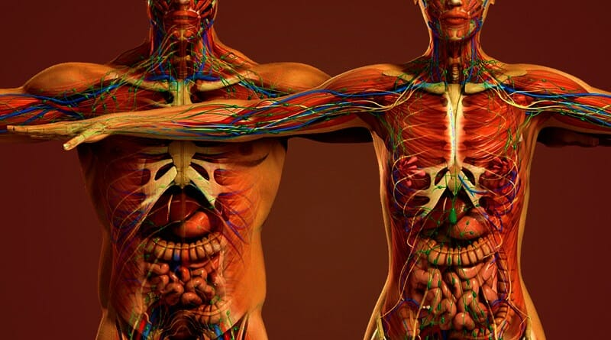
Biological Sex
Have you ever experienced any incongruence between your biological sex and your gender expression or identity?
Have you ever felt like your body betrayed you?

Slide 10
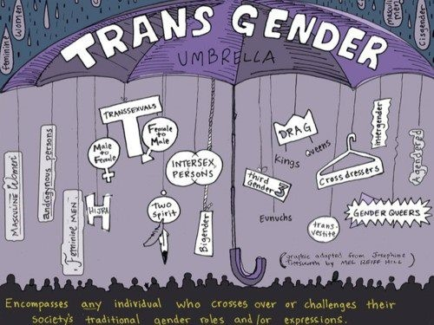
Terms to Know
Transgender: A person whose gender identity differs from their gender assigned at birth, and whose gender expression consistently varies from stereotypical expectations and norms. Also used as an umbrella term for anyone who defies gendered expectations in their biology, expression, or identity.

Slide 11
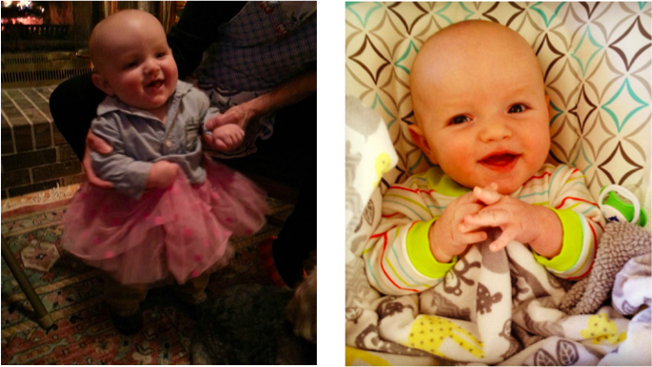

Slide 12
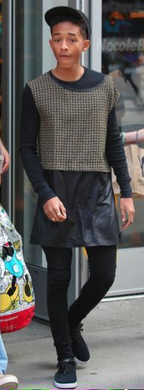
Gender Expression
Gender presentation: Clothing, hair, accessories, mannerisms
Gender expectations:
Roles (in relationships and professionally), behaviors, and interests
Notes:
Gender expression, put very simply, is the combination of the way we present ourselves physically, what we do, and what we like. We describe these various aspects of ourselves or other people on a spectrum of masculine and feminine. It’s important to realize that what is viewed as masculine or feminine is defined by society, and changes generation to generation. A simple example would be hair length. In your generation, was it common for men to have long hair? Okay, what about your parents’ generation? Your grandparents’ generation? Are men with long hair viewed as feminine now? But this idea extends to a variety of presentations and expectations. Each of us has a unique combination of masculine and feminine traits—almost no one is completely stereotypically masculine or feminine.

Slide 13
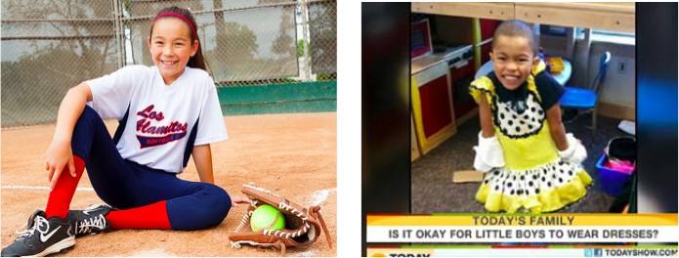
Gender Expression
In what ways does your gender expression differ from what might be expected of you based on your gender biology?
Have you ever been chastised for your gender presentation (how you look or groom?) Your gender roles or interests?
Notes:
In the longer workshop, we will engage in discussion after each axis of gender and explore how each impacts our lives in pairs or in the large group. For this shorter presentation, I invite you to think about what kind of feedback you have gotten for the way you have expressed your gender—this could be from when you were a child or in the workplace (thinking about professional dress, etc.)

Slide 14
Terms to Know
Gender non-conforming: A person who displays a gender expression that may differ from those typically associated with one’s sex assigned at birth. A gender non-conforming person may not identify as transgender.
Example — A man who paints his nails.

Slide 15
Gender Identity
Gender identity: Deeply-held internal sense of one’s gender, which may or may not match with what gender one is assigned at birth
Notes:
So, we’ve covered two axes of gender that most people are somewhat familiar with. This third piece, gender identity, is often something that people don’t think about when considering gender because they feel that the gender they were assigned at birth is congruent with how they feel about themselves. Gender identity is the Deeply-held internal sense of who one is, which may or may not match with what gender one is assigned at birth.
This process usually begins with internal exploration and acceptance and moves to external changes, which can be legal, medical, or social in nature.

Slide 16
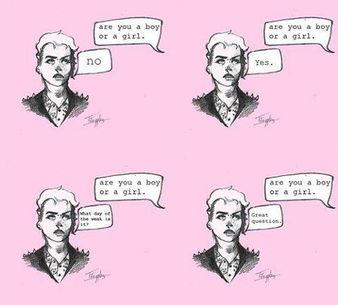
Terms to Know
Non-binary: A person whose gender identity or expression is beyond the male or female binary paradigm.
Notes:
I want to go through some terms that we’ll be using in the course of this presentation that are also included on your handout.

Slide 17
Gender Identity
Have you ever questioned the sex you were assigned at birth?
Can you imagine such a questioning?
“Have you ever questioned the nature of your reality?”

Slide 18
Sexuality Versus Gender Terms
Sexual Orientation (Who you’re attracted to)
Gay
Lesbian
Same-gender-loving
Bisexual
Heterosexual
Pansexual
Asexual
Queer
Questioning
Two-Spirit
Gender Identity (How you understand yourself)
Transgender
Cisgender
Nonbinary
Gender non-conforming
Genderqueer
Gender fluid
Pangender
Agender
Questioning
Two-Spirit

Slide 19
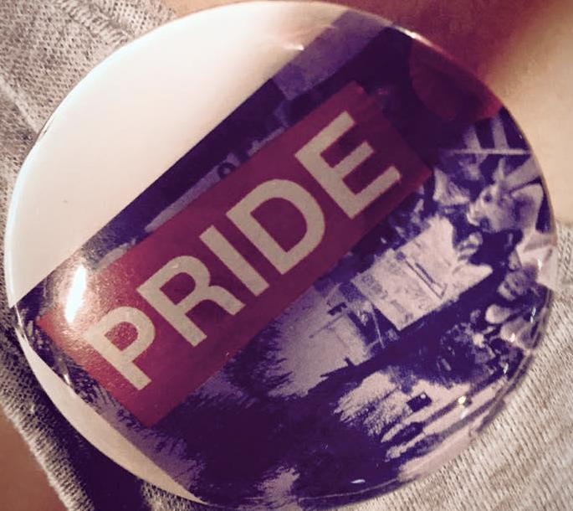
AT THE END OF THE DAY…
The best practice is just to ask:
What does that mean to you?
What does that look like for you?

Slide 20
Pronouns

Slide 21
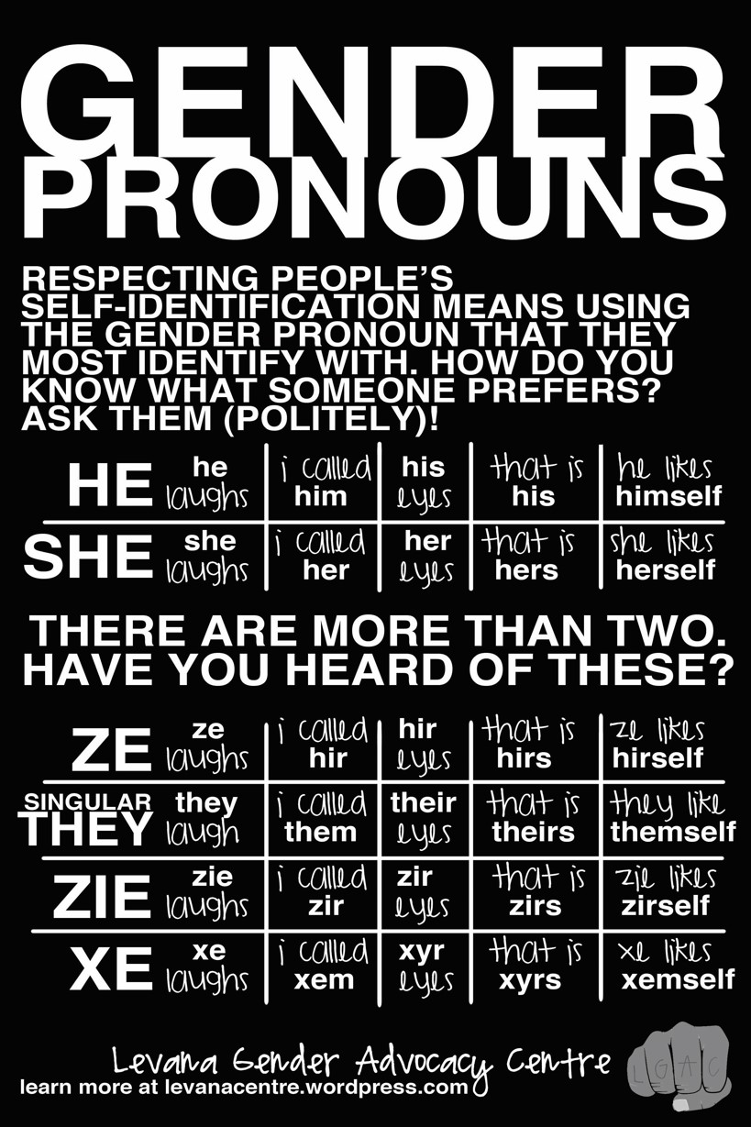
LET’S TALK ABOUT PRONOUNS!
Also known as Gender Pronouns (GPs) or Preferred Gender Pronouns (PGPs)

Slide 22
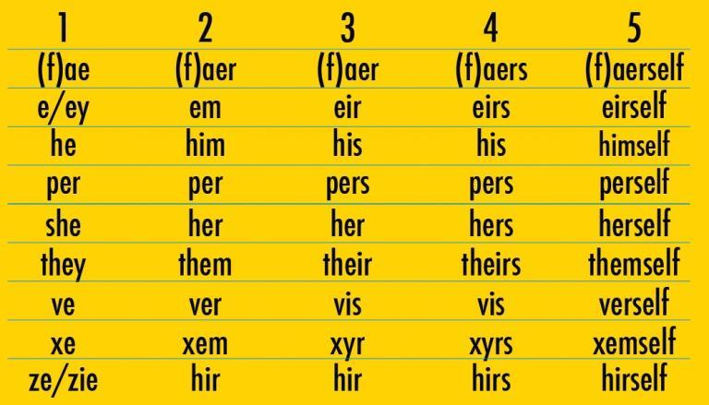
Pronouns
Why are pronouns important?
In small groups: Practice asking others their gender pronoun
Practice using “they/them/theirs” to refer to an individual: “They are an engaging speaker;” “I didn’t quite understand them when they said…” “Their presentation reminded me of…”
Some institutions make this part of culture, school orientation, etc.
Notes:
Also correspond to handout?

Slide 23
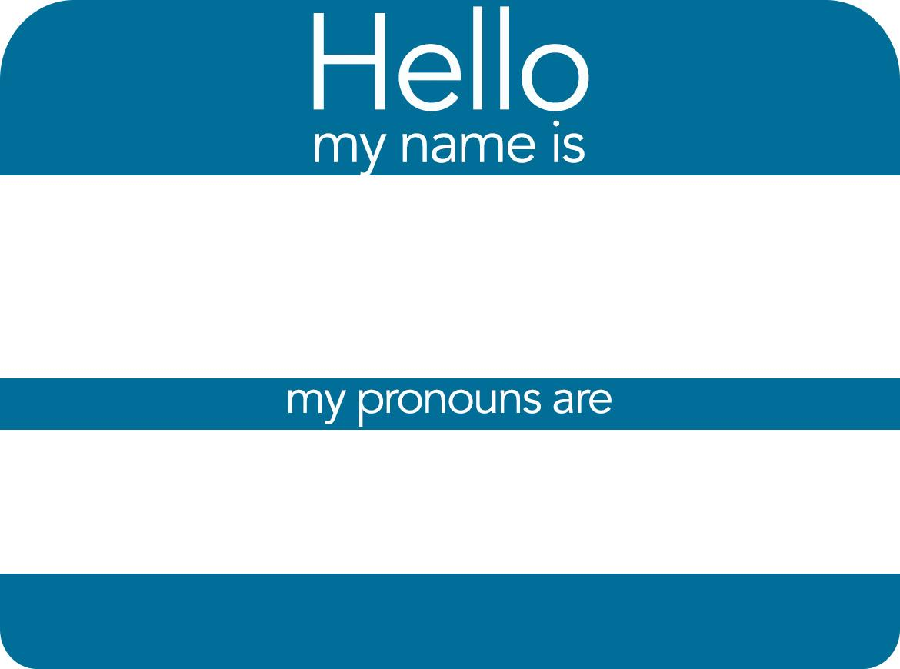
Pronoun Role Plays
3 roles: Person A (gets pronoun wrong), Person B (whose pronoun it is), Person C (bystander)
Script: Person A: Have you seen her new dog?
Version 1: Person B: I actually use he/him/his pronouns. Person A: I’m sorry—have you seen his new dog?
Version 2: Person C: I have seen his new dog—really adorable.

Slide 24
Pronoun Best Practices
What if I call someone by the wrong pronoun?
Best practice is to acknowledge the mistake, apologize, and move on, saying something like, “I’m sorry, I meant to say [insert pronoun.]” Then continue the conversation.
If you don’t catch your mistake until later, apologize to the person in private.
Effusive or repetitive apologies can make things more uncomfortable! Try to have compassion for yourself in making a mistake.
What if someone else uses the wrong pronoun for another person?
If possible, model the correct pronoun for the person in the moment, e.g. “I agree, they have been a joy to collaborate with.”
Be mindful of confidentiality and disclosure of someone’s identity.
Notes:
Also correspond to handout?

Slide 25
Disparities Among LGBTQ+ Seniors

Slide 26
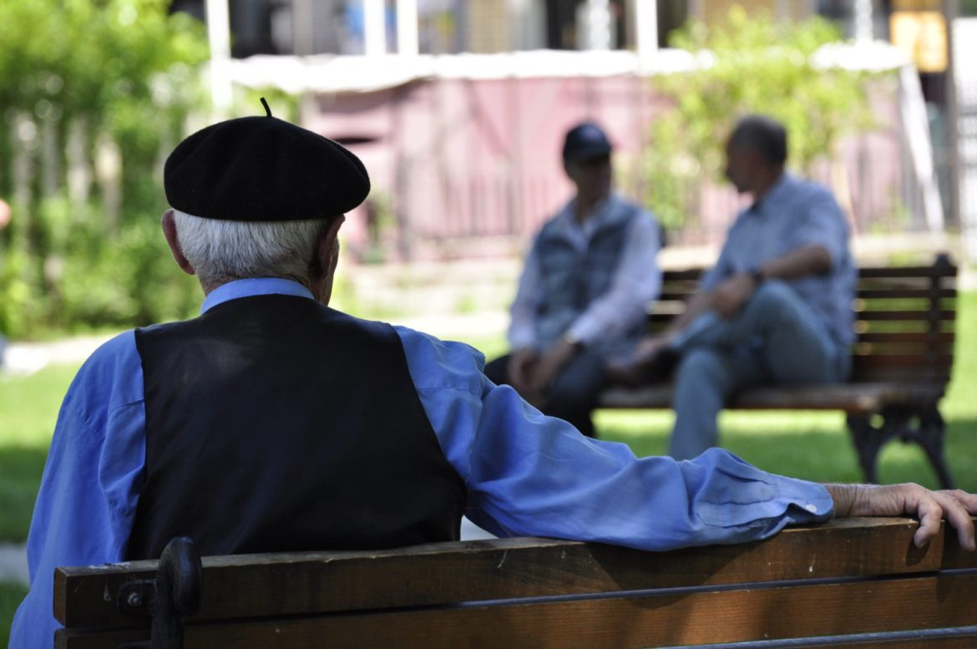
Disparities
More than 39 million people in the U.S. are age 65 years or older including 2.4 million people who identify as lesbian, gay, bisexual or transgender (LGBT).
As the baby boomer generation ages, the older adult population will increase from 12.8 percent to an estimated 19 percent in 2030 (American Psychological Association)
Social isolation, identity concealment
Discrimination in access to services (housing, healthcare, economic)
Less likely to have children and familial support networks for care
Notes:
*Taken from: http://www.healthypeople.gov/2020/data-search/Search-the-Data?&f[0]=field_topic_area%3A3494

Slide 27
Shame & Stigma
Stigma: Negative societal attitudes and general climate of hostility and exclusion for a subgroup of the population
Shame is the intensely painful feeling or experience of believing we are flawed and therefore unworthy of acceptance and belonging

Slide 28
Generational Patterns
LGBTQ members of the Silent Generation (born between 1925 and 1945)
LGBTQ Baby Boomers (born between 1946 and 1964)
LGBT Gen Xers (born between 1965 and 1980)
LGBTQ Millennials (born between 1981-1996)
A Gallup poll published in 2017 found that “the portion of American adults identifying as lesbian, gay, bisexual or transgender (LGBT) increased to 4.1% in 2016 from 3.5% in 2012 . . . The portion of [Millennials] identifying as LGBT increased from 5.8% in 2012 to 7.3% in 2016. LGBT identification remained relatively stable over the five-year period [2012–16] at 3.2% among Generation X and declined slightly from 2.7% to 2.4% among baby boomers” (Gates, 2017).
71 percent of Millennials favor same-sex marriage, compared to 56 percent of Gen Xers, 46 percent of Baby Boomers, and 38 percent of the Silent Generation (Pew Research Center, 2016).
https://www.asaging.org/blog/two-steps-forward-one-step-back-story-lgbt-gen-xers
Notes:
*Taken from: http://www.healthypeople.gov/2020/data-search/Search-the-Data?&f[0]=field_topic_area%3A3494

Slide 29
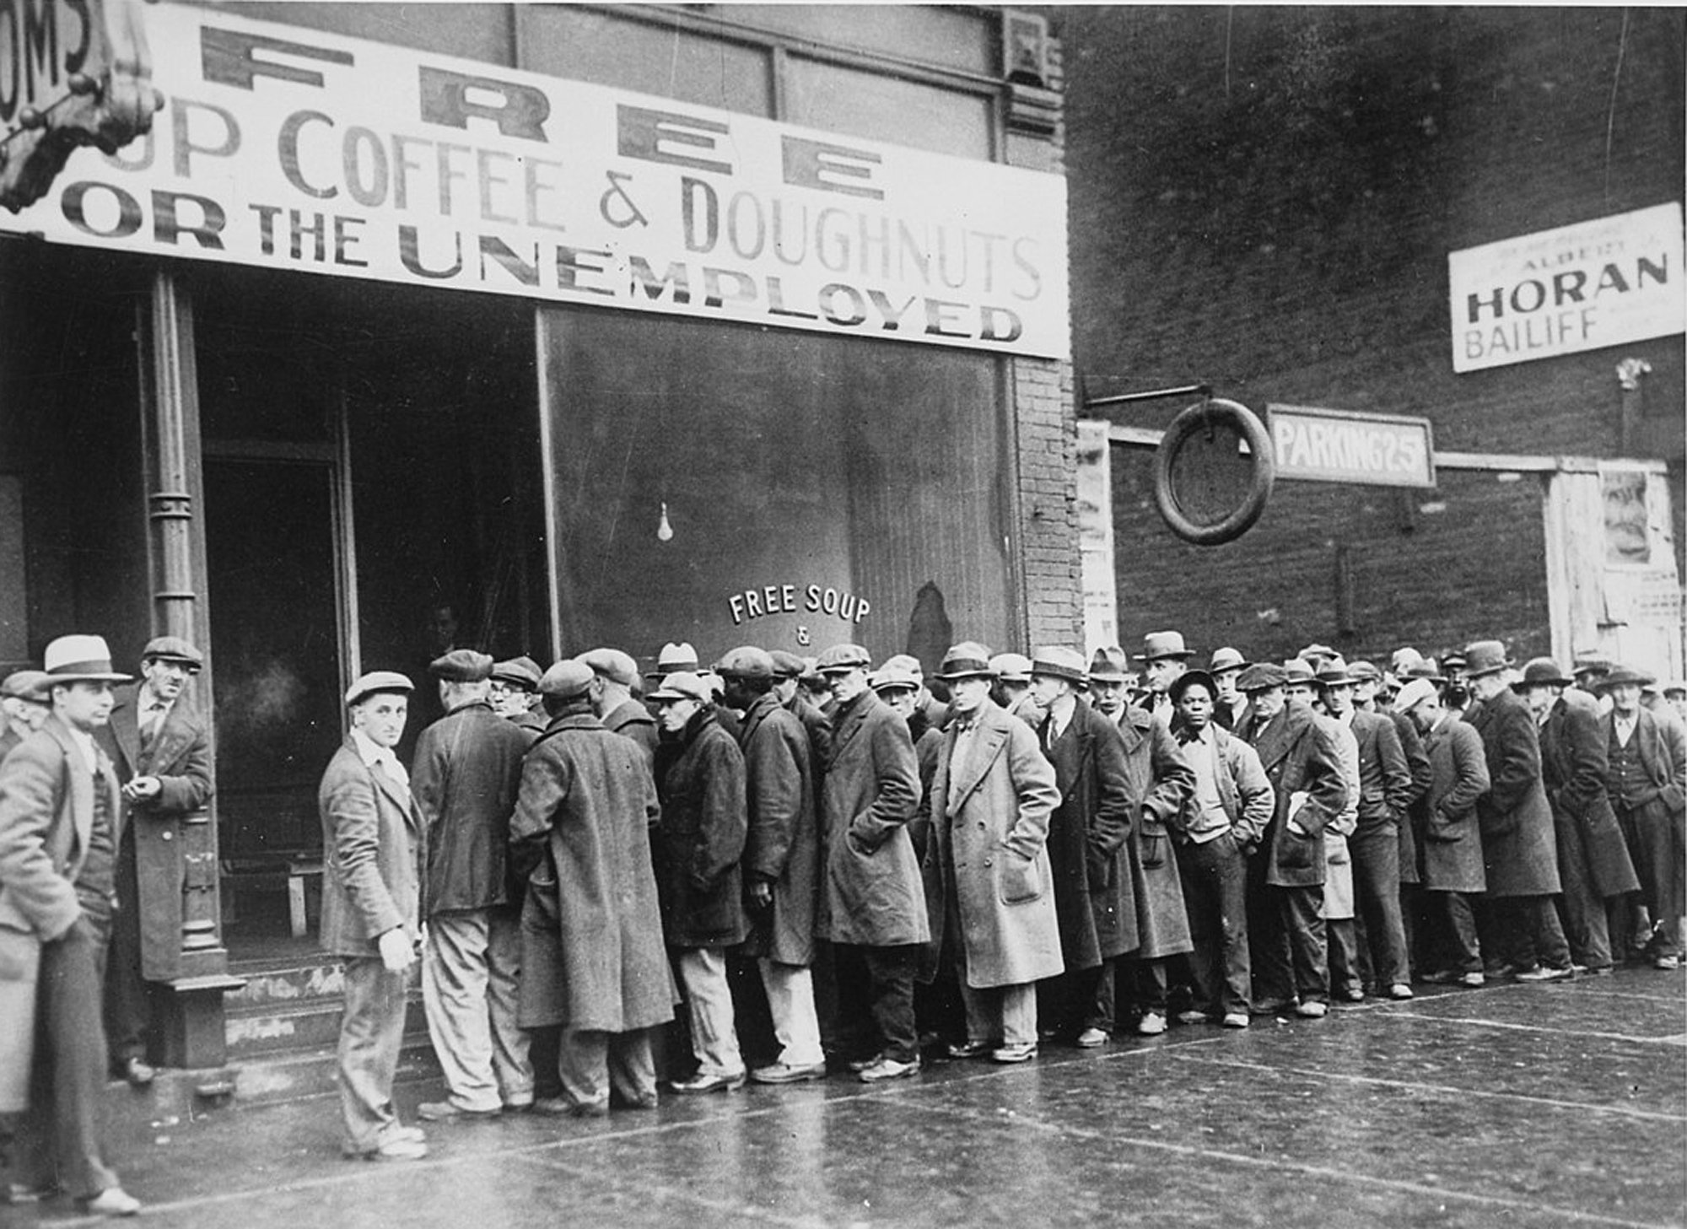
Generational Patterns
LGBTQ members of the Silent Generation (born between 1925 and 1945) have spent most of their lives in a climate extremely hostile to LGBT communities. Some have been closeted for their entire lives, some came out early on, others in their later years. They may carry with them memories of isola­tion, violence, and fear that make it difficult to openly identify as members of the LGBT com­munity, but also they carry strength, resilience, and courage.
“Homosexuality,” “sodomy” criminalized
Homosexuality listed as psychiatric diagnosis in DSM
Regular raids of LGBTQ bars, dances, and other spaces
Shaped by McCarthyism and Lavender Scare
First gay rights organizations developed in 1950s (Mattachine Society-1950, Daughters of Bilitis, 1955)
https://www.asaging.org/blog/two-steps-forward-one-step-back-story-lgbt-gen-xers
Notes:
*Taken from: http://www.healthypeople.gov/2020/data-search/Search-the-Data?&f[0]=field_topic_area%3A3494

Slide 30
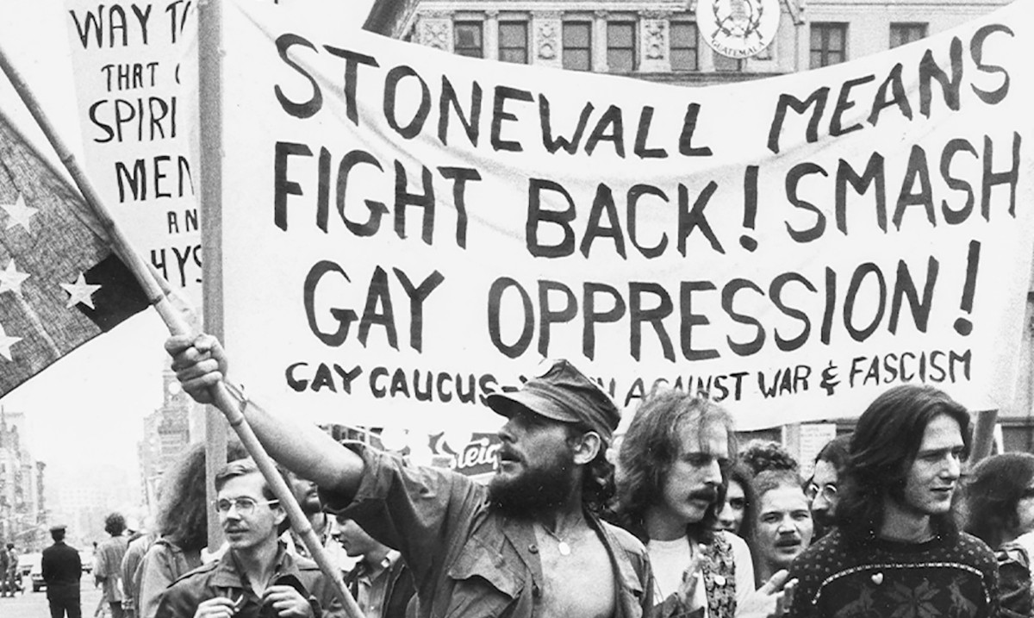
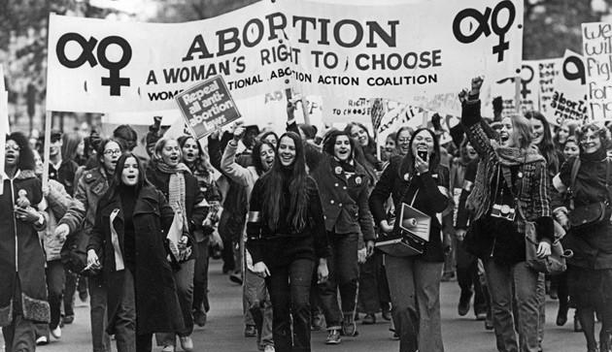
Generational Patterns
LGBTQ Baby Boomers (born between 1946 and 1964)
Shaped by civil rights movement
Beginnings of gay rights movement, i.e. Stonewall (1969)
Beginnings of sodomy decriminalized
Homosexuality no longer psychiatric diagnosis
Christine Jorgensen transition in media
Harry Benjamin Standards of Care developed for access to surgery and hormones for trans people
https://www.asaging.org/blog/two-steps-forward-one-step-back-story-lgbt-gen-xers
Notes:
*Taken from: http://www.healthypeople.gov/2020/data-search/Search-the-Data?&f[0]=field_topic_area%3A3494

Slide 31
Generational Patterns
LGBT Gen Xers (born between 1965 and 1980) were born and came of age during a transitional time in the march toward a world that is more accepting of LGBT people. Building on the work of the Baby Boomers, they have pushed for major advances in equal treatment, but change has happened slowly and with considerable pushback.
distrust of systems
Impacted by HIV/AIDS
LGBTQ Millennials (born between 1981-1996) have come of age during a time of rapid advancement in the improved treatment of LGBT people, and this is the generation most likely to be accepting of LGBT people
https://www.asaging.org/blog/two-steps-forward-one-step-back-story-lgbt-gen-xers
Notes:
*Taken from: http://www.healthypeople.gov/2020/data-search/Search-the-Data?&f[0]=field_topic_area%3A3494

Slide 32
Title 22 Requirements

Slide 33
Title 22 Training Requirements
2017 LGBT Training Requirements for congregate living health facilities (CLHFs) and skilled nursing facilities (SNFs)
Each facility’s registered nurses (RNs), licensed vocational nurse, certified nurse assistant (CNAs), and medical director must attend a training once every 2 years
The training must cover:
Definitions of common terms and examples associated with sexual orientation, gender identity, and gender expression;
Methods of communicating with or about LGBT individuals;
The health and social challenges historically faced by older LGBT persons, including discrimination in the health care setting;
The importance of professionalism in the medical settings and the way caretaker attitudes affect health care access and participation and overall physical and mental health outcomes;
Methods to create a safe and affirming environment, the legal and professional obligation to treat all patients in a nondiscriminatory manner, and the penalties for failing to meet legal and professional standards; and
Legal issues relating to LGBT persons, including but not limited to patients’ rights, civil rights, marriage and domestic partnership laws, and the Nursing Home Reform Act.

Slide 34
Best Practices

Slide 35
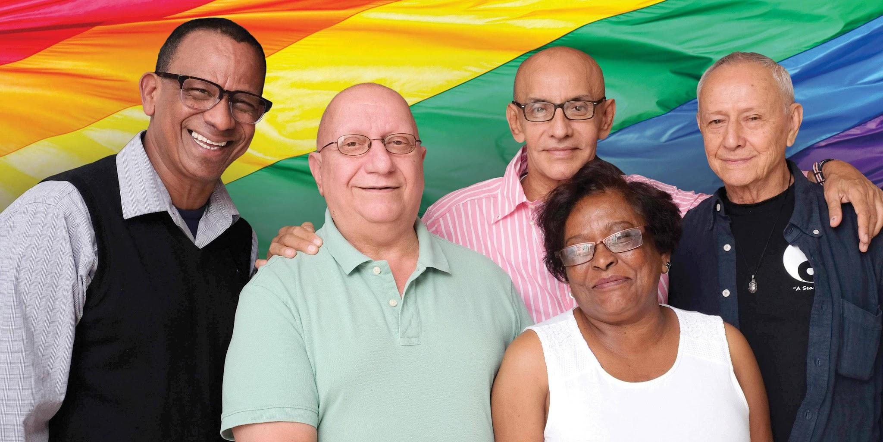
Best Practices
Don’t assume all clients are heterosexual and/or cisgender
Seniors have sex lives but may not have safe sex education
Be aware of coded language (i.e. “roommate,” “special friend”)
Be aware of whether family members are supportive and who a patient/client is out to
Denying a senior the right to express their identity (i.e. wear clothes that reflect their gender) in order to receive services/have access to resources may, in some cases, constitute elder abuse
Alternatives to sex-segregated spaces
Identify allies in your facility (patients/clients and staff)

Slide 36
Resources

Slide 37
LGBTQ Senior Resources
Lavender Seniors of the East Bay: Local (Oakland-based) resource. Local events (Hayward, San Leandro, etc.), friendly visitor program, resources. https://lavenderseniors.org/
SAGE: Advocacy and services for LGBT Elders, have research and resources, provide training, and opportunities for seniors to connect. https://www.sageusa.org/
National Resource Center on LGBT Aging: Includes resources on programming for LGBT elders and care for trans seniors. https://www.lgbtagingcenter.org/

Slide 38
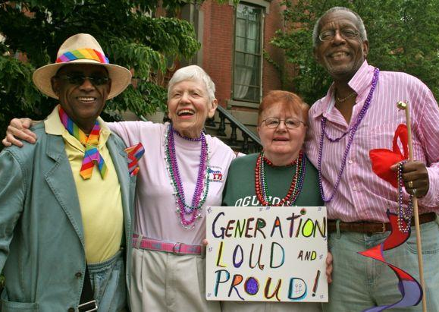
Rainbow Senior Services:
Food Pantry – Serving qualified member supplemental food resources
Senior Luncheon – Day long social event with morning coffee & cakes, lunch and a guest speaker from the community.
Friendly Visitor Program – In-home case management addressing issues of isolation and home safety & security.
SOAP (Senior Outreach & Advocacy Program) – Education on cultural competency and advocacy for LGBTQ senior in care facilities.
Clinical Services – Counseling and/or case management services.

Slide 39
References
Choi, S.K. & Meyer, I.H. (2016). LGBT Aging: A Review of Research Findings, Needs, and Policy Implications. Los Angeles: The Williams Institute.
Movement Advancement Project, et. al. (March 2010) Improving the Lives of Older LGBT Adults. Movement Advancement Project, Service and Advocacy for Gay, Lesbian, Bisexual, and Transgender Elders (SAGE.)
Kristen E. Porter PhD, Mark Brennan-Ing PhD, Sand C. Chang PhD, lore m. dickey PhD, Anneliese A. Singh PhD, Kyle L. Bower MA & Tarynn M. Witten PhD, LCSW, FGSA (2016): "Providing Competent and Affirming Services for Transgender and Gender-Nonconforming Older Adults," Clinical Gerontologist.
American Society on Aging, (2010) Still Out, Still Aging: The MetLife Study of LGBT Baby Boomers, MetLife Mature Market Institute.
Johnson, Tim. (2017) “Two Steps Forward, One Step Back: The Story of LGBT Gen Xers.” American Society on Aging, https://www.asaging.org/blog/two-steps-forward-one-step-back-story-lgbt-gen-xers
American Psychological Association (n.d.) “Lesbian, Gay, Bisexual, and Transgender Aging.” https://www.apa.org/pi/lgbt/resources/aging

Slide 40
Thank you!
2118 Willow Pass Road,
Ste 500
Concord, CA 94520
Office: 925.692.0090
Fax: 925.692.0091
Email: rcc@rainbowcc.org
Notes:
Move to after contact info

