Slide 1


Aging Nation Virtual/Webinar 2020
October 22, 2020 - 9:00AM to 1:00PM

Slide 2

Our Aging Nation
Home Care Assistance
Hospice East Bay
Celebrating our 10th year of Community Education
Thank you to all who have contributed from both organizations over the years.
Thank you to all who have participated

Slide 3
Where You Can Find PowerPoints from our Speakers
Please visit https://eldercareanswers.com/event/ouragingnation2020/
for PowerPoints for all of today’s speakers

Slide 4
Outline
09:00 Welcome
09:15 Viki Kind
10:15 Nicolle Ionascu
11:15 Mindfulness with Hospice East Bay
11:30 Micheal Pope
12:30 Wrap Up and Q/A with the speakers

Slide 5
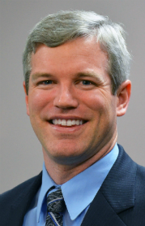
Brian O’Toole
Attorney At Law
Welcome
Brian O'Toole’s practice emphasizes Estate Planning, Elder Law, Medi-Cal Eligibility, Long-Term Care Planning, Trust Administration, and Probate Administration. In addition to creating wills and trusts, administering trusts, and navigating probate court, he is particularly experienced in creating strategies to protect assets from the overwhelming costs associated with skilled nursing home care.
Brian attended the University of California at Davis and completed his undergraduate work in 1999, receiving a Bachelor of Science in Genetics and a Bachelor of Arts in Philosophy. From 2001 to 2003 Brian served in the Peace Corps as a health adviser in The Gambia, West Africa. He received his J.D. from the University of California, Hastings College of the Law.
Brian is a member of the National Academy of Elder Law Attorneys, has created and presented continuing education courses for attorneys in estate planning and elder law at the University of Pacific McGeorge School of Law, and often provides informational seminars for various organizations, including Eldercare Services and local schools.

Slide 6
Viki Kind
Welcome
Housekeeping items
Please remain logged in for full webinar
Please participate in polls and questions
Please remain muted
Please submit all questions through the Chat, each presenter will answer questions at the end of their presentation. We will have a Q & A with our Panel at the end of the day.
PowerPoint slides are available here:
https://eldercareanswers.Com/event/ouragingnation2020/
Please be sure to submit your completed evaluation which will be emailed at the end of the presentation today. Please email it back to sgunnett@homecareassistance.com
If your email address changes please email sgunnett@homecareassistance.com
For those who successfully watch, participate and submit their evaluation form, a certificate will be emailed to you. Please allow two weeks for e-mail delivery of your certificates.

Slide 7
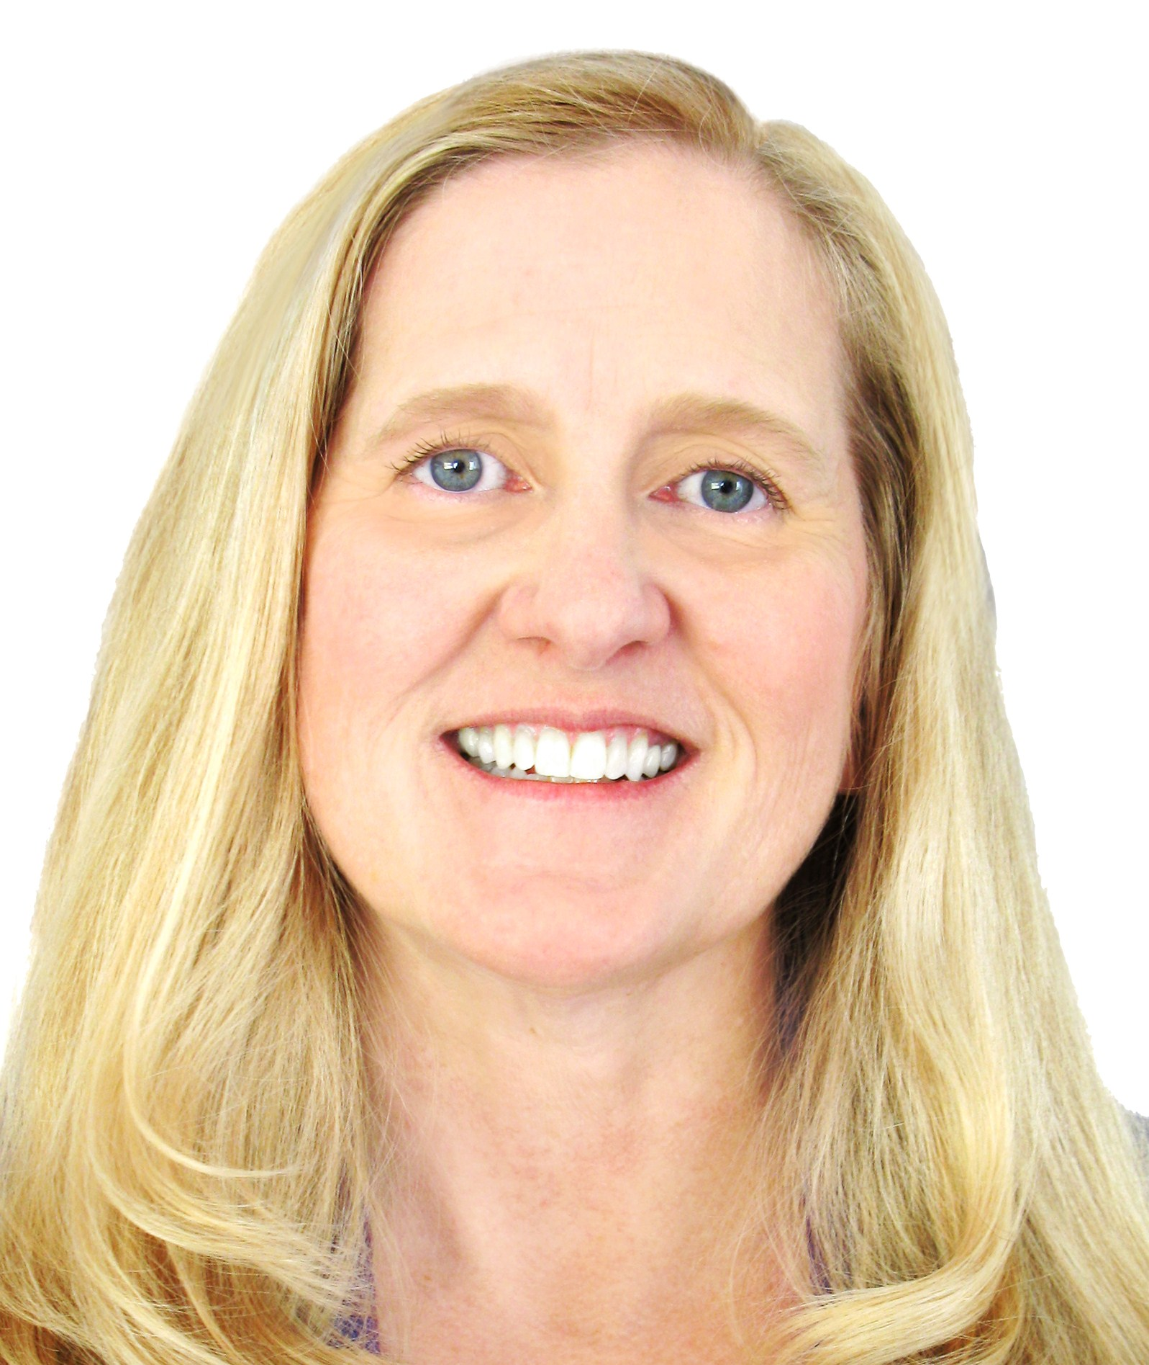
First Speaker: Viki Kind
9:15 AM: Evaluating Risk, Danger and Safety When Creating the Care Plan
Viki Kind is a clinical bioethicist, award winning author, and professional speaker. Her book, The Caregiver’s Path to Compassionate Decision Making: Making Choices For Those Who Can't, guides families and professionals who are making decisions for those who have lost capacity. Viki is known as “The People’s Bioethicist,” because she is a rare individual who bridges two worlds, that of the health care professional and of the family struggling to make the right decisions. Viki spends much of her time speaking at conferences out in the community teaching patients and family caregivers how to make better health, life and end-of-life decisions. She also lectures across the United States teaching professionals to have integrity, compassion and to improve care through better communication and ethical frameworks. She is an honorary board member of the Well Spouse Association and has been a caregiver for many years for six members of her family.

Slide 8
Evaluating Risk, Danger and Safety When Creating the Care Plan
Presented by Viki Kind, Bioethicist
kindethics@gmail.com
KindEthics.com
805-807-4474

Slide 9
Should I Step In?
Notes:
Begin by looking at “Should ” I step in? The answer is, “It depends.” It depends on whether or not the person the enough mental capacity.

Slide 10
Capacity vs. No Capacity
Capacity for what?
  To express preferences?
  To see the dangers?
  To understand the consequences?
Can the person connect the dots?
A person can be very verbal and charming but not be able to understand the dangers
Notes:
Hold enough pieces of information and then connect the dots to be able to see the big picture. Think out into the future. Abstract thinking. Dad, I am picking you up for lunch…

Slide 11
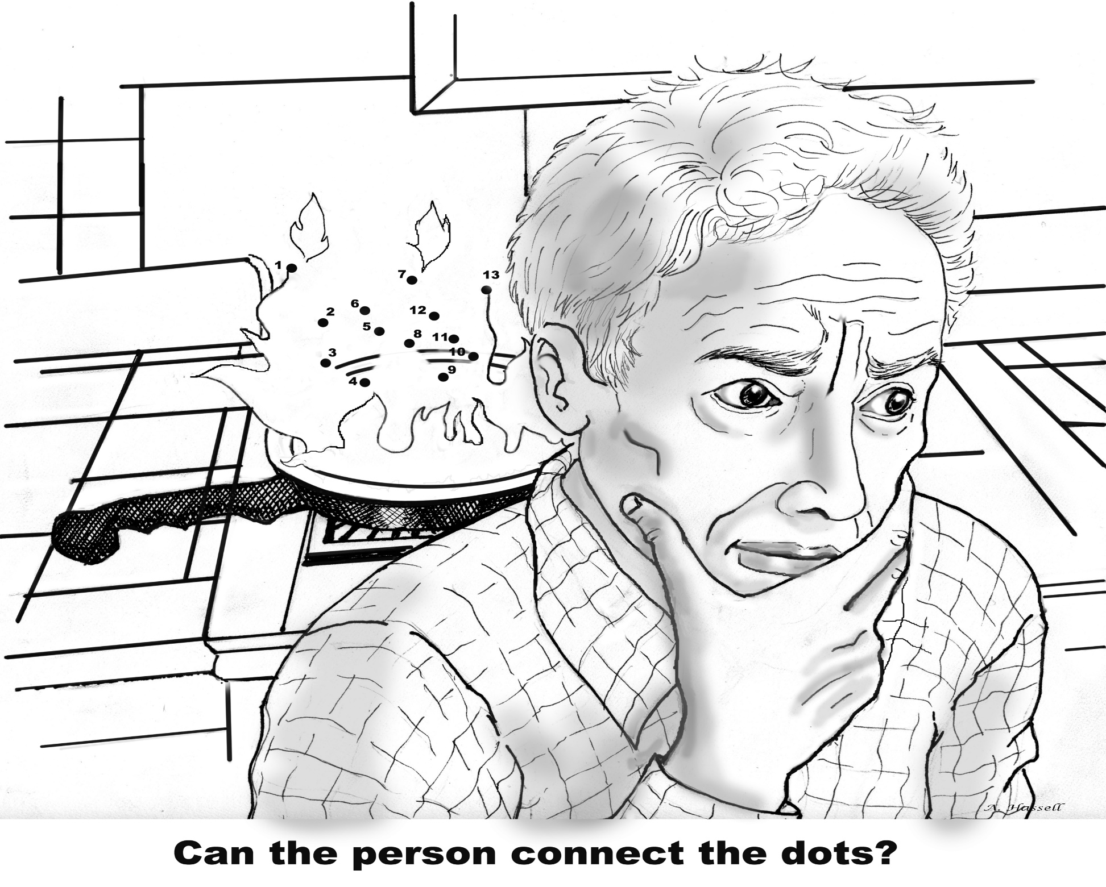

Slide 12
Living In Danger
How Much Risk Is Allowed?
For Someone With Capacity?
For Someone Without Capacity?
Help! My Dad Is Falling!

Slide 13
Respecting the Decisions of the Person Who Has Capacity
Autonomy – People, with full capacity, have right to determine course of their lives
People have the right to make a wrong decision
Limit to this right – The Harm Principle: “When our actions cause significant harm to others.”
Report most serious harms
Power is in our communication
Notes:
We each get to determine the course of our lives and that includes taking certain risks. These risks might include continuing to smoke, bungee jumping, spending more money than we make, etc. All of these actions put us in some amount of danger but we have the right to choose to live with a certain amount of risk.
Our right to live our lives the way we want does however have a limit. The limit is when our behaviors start hurting other people. For instance, you can get drunk in your own house and you may not be a danger to others, but if you get in a car, you are now a danger to the rest of society. This is the boundary for danger when you have capacity. You can’t create a potential harm to others.

Slide 14
Developmental Tasks/Stages
Control: Older senior feels the loss of control over the changes that are happening to his or her body, mind and life. Saying “No” = control
Legacy: End-of-life work or “life review” which processes questions such as: “Did I matter?” “Will anyone remember me?” “What is the legacy I am leaving to my family and to this world?”
How to Say It To Seniors by David Solie, MS, PA
Notes:
loss of strength, health, peers, consultative authority (social purpose), identity, physical space (not focused on safety, focused on memories), financial independence, – some losses can’t be regained or replaced – they can’t always take the action we want because they just don’t have the strength, stamina to do it – ONE THING THEY HAVE POWER OVER IS “NO” – they are not interested in your goal,

Slide 15
Continued…
Slowing down when aging is normal – not always a sign of physical or mental decline
Senior – goal is to “ponder and process”
Middle-age – driving force get things done quickly
Creates conflicts regarding speed and timing
Solution: There is power in backing off and allowing the senior some space and time
Be aware of our professional speed and pace

Slide 16
Frame as Short-term Control
vs. Long-Term Control
“In the short term, of course you can choose to not use your walker, It does worry me (It concerns me) that in the long term, you may be sacrificing long-term control if you break your hip and can’t live at home anymore. Then you wouldn’t have any control over where you live, what you eat, how you structure your day, etc.”
“Of course, it is your decision.”

Slide 17
Our Obligations Change
When the Person Lacks Capacity

Slide 18
But She is Okay Some of the Time!

Slide 19
I Don’t Want to Accept That Mom Needs Help!
Do you know which days or times she will be fine?
If a fire, will she be able to get out of the house?
Even on the days when she isn’t doing well?
Can’t predict which days she will be worse
I had the sisters repeat to themselves: “We can’t take a chance that the danger will happen on one of her bad days.”
Notes:
Two sisters - Their gut was saying, we need to do something, but they were hesitant because it felt wrong to tell their mother what to do

Slide 20
The Shared Decision Making Model
Approximate Developmental Age | Decision Making Tool | With adults, who participates?
Age 0–6 | Decision Maker’s Consent | The patient’s decision maker uses Substituted Judgment or the Best Interest Standard.
Age 7-13 | Assent | The decision maker, with the help of the doctor if needed, talks to the patient about the medical decisions and gets the patient’s assent/dissent. The decision maker gives the final consent.
Age 14-17 | Consent | If the patient has enough capacity, the patient uses autonomy and makes the decisions. If not, you move back up one level and use Assent.
Notes:
Can the person stay home alone?

Slide 21
Figuring Out Mental Age Range
Can or should you leave the person home alone?
Can they make a sandwich?
What kind of sandwich? Would you give them a knife to cut the sandwich?
Would you let them carry $20 in their pocket? $100?
Would you let the person babysit your kid?

Slide 22
How serious is this situation?
Is it safe for the person to participate?
The Sliding Scale Decision Making
No capacity | A little bit of capacity | Some capacity | Almost full capacity | Full capacity
No decision making | Some small decisions | Daily decisions and some voice in medical decisions, but not life-and-death decisions | Larger voice in important decisions | Full voice in his or her own decisions, including life-and-death decisions
Notes:
What age do people drive in …? Then, dad choosing his room, his furniture, then I brought his safety chair for the bathroom. 8yo grandfather driving

Slide 23
It is no longer,
“Should We Step In?”
The question is now,
“When Should We Step In?”
Notes:
For my dad, I knew I had to step in. For these sisters, the next question was how soon did they need to get a plan in place?

Slide 24

Watching Out For Red Flags
Has the Person Changed?

Slide 25
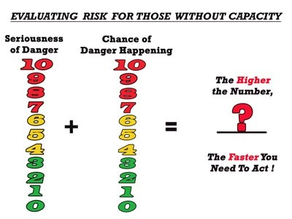
Balancing the Seriousness with the Chance the Danger Will Happen
Notes:
Use dad falling as an example

Slide 26
What is this person’s score when he or she is not thinking clearly?
Showering
Turning on the stove
Wandering
Managing money
Taking medications

Slide 27
Short-Term Plan vs. Long-Term Plan
Lower Score: Take some time to develop a good long-term plan which both protects the person and provides a good quality of life
Higher Score: Take action quickly and put a short-term plan in place. Then take some time to create a better long-term plan
Notes:
You can’t afford her over-dosing or under-dosing on her critical medications. Someone needs to stay at house to protect her, or take meds out of house and stop by each day to give her meds. Of course, these aren’t great long term solutions, so you are going to have to research different options.

Slide 28
Creating a Plan That Keeps the Person Safe While Providing for a Good Quality of Life
Notes:
The plan wasn’t working for my dad so I needed to create a better plan to keep him safe, and happy

Slide 29
Balancing Reducing Risk While Improving Person’s Quality of Life
A life without danger may mean a life without meaning
What are the burdens of the solution?
  Emotional, physical, loss of control and dignity?
What will it feel like and be like for the person to experience this decision?
If the person loses a part of their quality of life, what can we add to put more quality back into their life?

Slide 30
Using the Worksheet to Develop
a Better Long-Term Plan
Are there experts I can ask for advice?
Will this option keep the person safe?
Will it create any new risks?
Can I include and empower the person in this decision?
What will it feel like and be like for the person to live with this solution?
What else can I do to improve this person’s quality of life while keeping him/her safe?
How much time do you have? Time to spend?

Slide 31
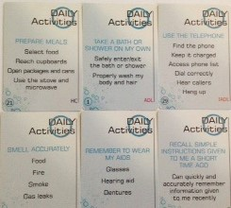
A Positive Approach To Evaluate the Situation, Person and Needs
The Cards I’ve Been Dealt
Notes:
Andrea’s cards

Slide 32
Can We Include and Empower The Person in the Solution?
Moving Dad to Safety

Slide 33
Steps to Asking for Assent/Dissent
1. Evaluate the person’s mental age, maturity level, psychological condition and ability to give assent/dissent.
2. Allow enough time to use an alternate method of communication.
3. Using developmentally appropriate language (language the patient can understand)
Use pictures, a video or a simply written handout.
Notes:
Fake choices, take my dad for a cat scan – see the room first, Cataract surgery

Slide 34
4. Give the person the details of the proposed treatment, test or surgery. Explain what the experience will be like from the patient’s perspective.
  What will it be like for the patient to experience the proposed treatment, test or surgery? Where will the test take place?
  Will the test hurt? Will the patient be left alone or can you stay with your loved one during the procedure?
5. If the person says yes, be careful that the person isn’t just saying that to make you happy.
6. If the patient doesn’t understand what you are talking about, then try again. If the person still can’t understand, then you shouldn’t use assent.
Notes:
Autism

Slide 35

Gratitude

Slide 36
Supported Decision Making
https://coalitionccc.org/tools-resources/people-with-developmental-disabilities/
Model Forms:
http://supporteddecisionmaking.org/node/390
http://www.supporteddecisionmaking.org/node/390
Supported Decision-Making Guides:
http://supporteddecisionmaking.org/legal-resource/supported-decision-making-brainstorming-guide
Webinar:
http://www.supporteddecisionmaking.org/education

Slide 37
Should the Person Participate?
What kind of decision needs to be made?
How much risk is involved?
How hard would it be to undo the decision?
Has the person made a decision like this before?
Is the decision likely to be challenged?
What is the least restrictive support?
Morgan K. Whitlatch, Legal Director, Quality Trust Lead Project Director, National Resource Center for Supported Decision-Making
Notes:
Morgan K. Whitlatch, Legal Director, Quality Trust Lead Project Director, National Resource Center for Supported Decision-Making SUPPORTEDDECISION-MAKING:
Update on U.S. Trends & Best Practices
Consumer Voice Conference November 7, 2017

Slide 38
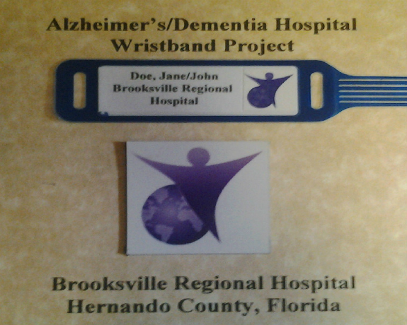
Dementia Wristband Project
Pts with prior diagnosis get Purple Angel wristband
Purple Angel on door so anyone entering knows to approach with patient’s special needs in mind
Dementia screening added to admission process
Use of “sitters” to allow families to take breaks
Hospital staff, volunteers and first responders receive training developed by Gary Joseph LeBlanc
www.commonsensecaregiving.com

Slide 39
Decision Making Tools
Go Wish Cards www.gowish.org (English/Spanish)
The Cards I’ve Been Dealt – Needs Assessment cards and Values and Wishes cards to help the patient and/or family review the patient’s abilities, needs and preferences www.thecardsivebeendealt.com
Thinking Ahead Project available in many languages http://www.coalitionccc.org
Consider the Conversation 1 and 2 –Documentaries about making the decisions meaningful www.considertheconversation.org
Great end-of-life website www.CAPOLST.org

Slide 40
Some of Viki’s Favorite Resources
They’re My Parents Too by Francine Russo
The Lost Art of Listening – How learning to listen can improve relationships by Michael P. Nichols PhD
How to Say it to Seniors – Closing the communication gap with our elders by David Solie, MS, PA
To Weep For A Stranger – Compassion Fatigue in Caregiving by Patricia Smith
Virtual Dementia Kit https://www.youtube.com/watch?v=LL_Gq7Shc-Y
My Stroke of Insight: A Brain Scientist's Personal Journey by Dr. Jill Bolte Taylor

Slide 41
Assessing and Reporting
American Medical Association Assessing Older Drivers resources: http://www.ama-assn.org/ama/pub/physician-resources/public-health/promoting-healthy-lifestyles/geriatric-health.page
Keeping Us Safe: www.keepingussafe.org
Department of Motor Vehicles – Anonymous reporting form

Slide 42
Q & A with Viki Kind

Slide 43
Dr. Nicolle Ionascu
Welcome
Housekeeping items
Please remain logged in for full webinar
Please participate in polls and questions
Please remain muted
Please submit all questions through the Chat, each presenter will answer questions at the end of their presentation. We will have a Q & A with our Panel at the end of the day.
PowerPoint slides are available here:
https://eldercareanswers.Com/event/ouragingnation2020/
Please be sure to submit your completed evaluation which will be emailed at the end of the presentation today. Please email it back to sgunnett@homecareassistance.com
If your email address changes please email sgunnett@homecareassistance.com
For those who successfully watch, participate and submit their evaluation form, a certificate will be emailed to you. Please allow two weeks for e-mail delivery of your certificates

Slide 44

Second Speaker: Dr. Nicolle Ionascu
10:15 AM: Social Isolation During a Pandemic: Depression, Anxiety & Trama
Dr. Nicolle Ionascu is a UCSF trained clinical neuropsychologist with over 15 years of experience in neuropsychological evaluation, diagnosis, and treatment of patients with developmental, age, and trauma related neuro-cognitive challenges.
She is the staff neuropsychologist in the Department of Neurology and Neurosurgery at UCSF Benioff Children's Hospital Oakland. Previously she was staff neuropsychologist at Presbyterian Hospital's Rehabilitation Center and Carolinas Center for Development and Rehabilitation in Charlotte N.C. She began her neuropsychology career at San Francisco General Hospital and Veteran's Affairs Medical Center in San Francisco.
Dr. Ionascu is a Co-founder of Eysz Inc. (a company dedicated to non-intrusive seizure detection), a Medical Advisory Board member for of SimpleTherapy Inc. (a company dedicated to alternative approaches to pain management), and an affiliate neuropsychologist for the Federal Aviation Administration (FAA) performing evaluations of Pilot and Air Traffic Controller cognitive and behavioral fitness. She is a Qualified Medical Evaluator with 10 locations throughout California and has conducted dozens of Independent Medical / Expert Witness evaluations.
Dr. Ionascu taught undergraduate and graduate psychology courses at Queens University and Argosy University. She co-authored numerous medical journal as well as magazine articles in the areas of neuropsychology and child development. Additionally she is a research neuropsychologist in clinical trials of rare developmental cognitive diseases. She obtained her undergraduate degree at U.C. Berkeley and her doctoral degree at the Wright Institute in Berkeley Ca.

Slide 45
Social Isolation During a Pandemic:
Depression, Anxiety & Trauma
Presented by Dr. Nicolle Ionascu

Slide 46
Life in the Pandemic:
Social Isolation & Mental Health
The notion that social isolation creates mental health problems is clear. However, research reveals that certain groups are at higher risk for poorer mental health outcomes:
  Children and Adolescents
  Older Adults
  Minority Groups
  Those from lower socio-economic groups
  Women
  Those with pre-existing mental health conditions
  Many older adults fall into most of these categories
  Journal of Clinical Nursing, 2020; 29: 2756-2757

Slide 47
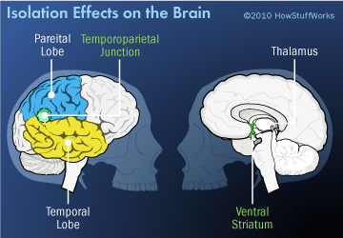
Isolation Impacts the Psyche and the Brain
The brains of lonely people react differently than those with strong social networks
One study found that when viewing pleasant pictures, non-lonely subjects showed much more activity in a section of the brain known as the ventral striatum than the lonely subjects. The ventral striatum plays an important role in learning
Additionally, when non-lonely subjects viewed unpleasant pictures, they demonstrated activity in the temporoparietal junction, an area of the brain associated with empathy; the lonely subjects had a lesser response
University of Chicago, 2019

Slide 48
Given that we know the brain and psyche are impacted… We must consider
Specific Increased Mental Health Concerns in the Elderly
Intervention Strategies
Self-Care and protection for the mental health clinician

Slide 49
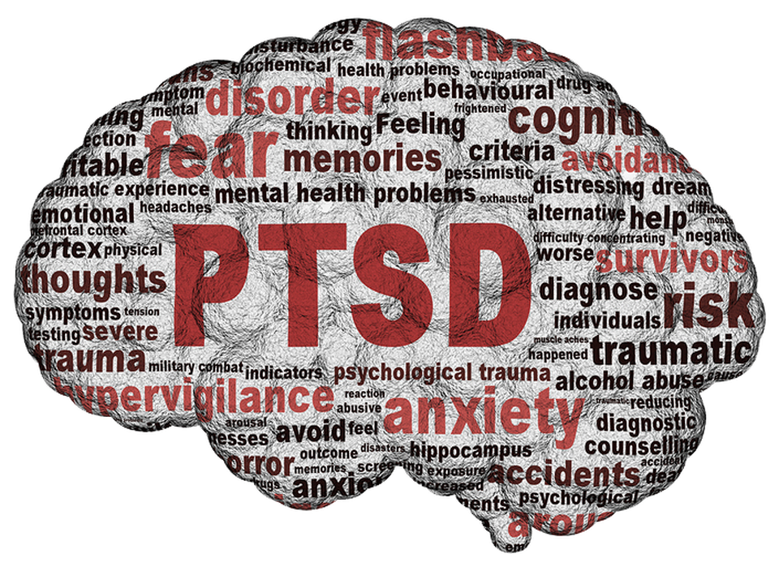
PTSD: The Trauma of Pandemic
Both earlier and recent findings suggest that infectious disease epidemics and pandemics can be highly traumatic and lead to PTSD and chronic psychological distress
Understanding risk factors is key for early identification, intervention and treatment

Slide 50
Probable Risk Factors for PTSD and Chronic Psychological Dysfunction
Level of Exposure
      Older adults are more like to report PTSD symptoms than middle aged adults
      Living in highly affected areas can be an independent risk factor of PTSD – particularly among older adults – even if the individual and those who are close to them do not contract the disease (Lee et al, 2006)

Slide 51
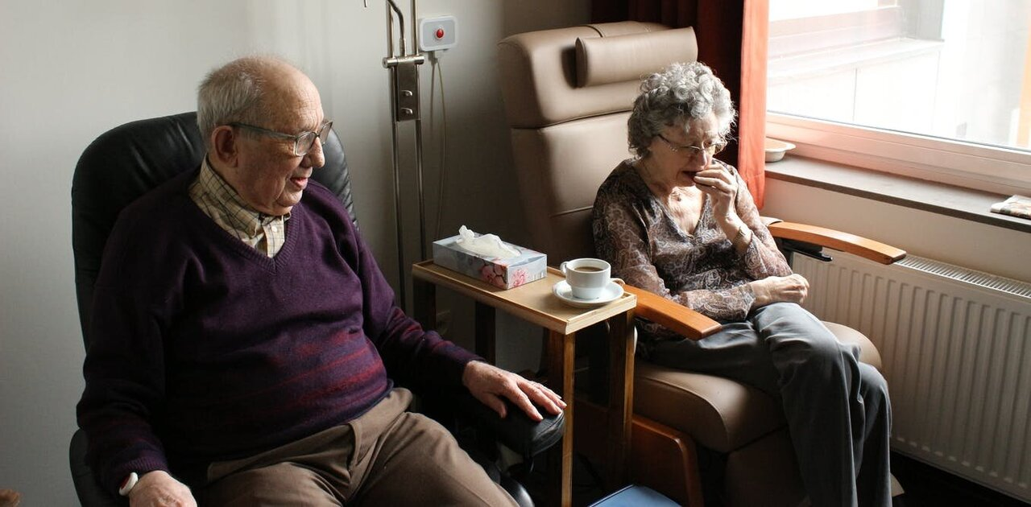
Continued
Other Risk Factors Revealed by Research
  Isolation
  Social inequalities
  Living with a Disability
  Gender
  Age
  As such, early detection of risk factors and early intervention play a critical role in mitigating the effects of Covid-19 on psychological functioning

Slide 52
Case Study: Anna
Anna is 60-year-old female who had recently been diagnosed with Post Concussive Syndrome
Due to the pandemic, her mother’s caregiver stopped coming, causing Anna to have to go care for her elderly mother
Anna, a nurse herself, was already on disability to due her concussion
Once Anna began to care for her mother her isolation increased

Slide 53
Continued
Anna had been engaging in PT and OT, both of which switched to telemedicine
She found herself canceling appointments to care for her mother
She became exhausted, developed nightmares, and described feeling in a mental fog
Anna was at high risk for PTSD due to the mechanism of her injury – the disruption of her mother’s care and the fact that she had to step in further increased her risk

Slide 54
Elders and Suicide: Increased Risk
The elderly are particularly susceptible to the adverse effects of isolation
Living alone, loneliness, and social isolation are well-recognized risk factors for suicide later in life
Before the pandemic, even older adults living in senior communities designed to reduce social isolation described moderate level of loneliness
Draper, 2014

Slide 55
Elders and Suicide: Red Flags
  Disconnectedness from society
  Physical Distancing
  Loss of usual social activities
  Fear of burdening society with increase healthcare needs

Slide 56
Forced Isolation:
Cognitive and Emotional Consequences
The Social Isolation Hypothesis introduced by Roger Faris in 1934:
  “Any form of isolation that cuts the person off from social relations for an extended period of time may potentially lead to a mental disorder” (1934:157)
Cognitively, social isolation (i.e. loneliness) is a risk factor for, and may contribute to, poorer overall cognitive performance, faster cognitive decline, poorer executive functioning, increased negativity and depressive cognition, heightened sensitivity to social threats
  John T.Cacioppo and Louise C.Hawkley, 2009

Slide 57
Increased Boredom Has Its Own Set of Consequences
EXCESSIVE SLEEP
EMOTIONAL EATING
INCREASED UNHEALTHY CONSUMPTION OF MEDIA AND RELIANCE ON SOCIAL MEDIA:
  A study in 2018 by Dhir et el suggests that compulsive media use significantly triggers social media fatigue, which then leads to elevated anxiety and depression.

Slide 58
Cognitive Dulling Due to Lack of Stimulation
Regression of progress made in treatments that cannot longer be offered can lead to sadness and increased feeling of hopelessness
Patients who previously had treatments are not making progress and no longer engaged the social aspects of care

Slide 59
Case Study: Edna
91-year-old female presented with depression and increased suicidality
In early March 2020 she had moved to a new residential care facility because she had fallen multiple times and felt unsafe living alone in her home of 35 years
In Mid-March when the shelter-in-place began she was unable to leave her room: Dinner was no longer served in the dining room; all social activities had been canceled
She reached out for telemedicine therapy to manage increased depression
When asked why therapy now “I want to jump off my balcony” and “If I get this thing, I’m not going to make it out alive”
Weekly telemedicine therapy focused on coping skills and opportunities for socialization in her limited environment and managing fear of becoming ill

Slide 60
Specific Concerns Related to Dementia
Patients with dementia may have trouble remembering to follow CDC Guidelines
Decreased ability to engage in motor activities related to safety
Case Example: Michelle
  75-year-old female with vascular dementia
  Referred for neuropsychological testing pre-surgical; certain tasks had to be completed in person
  She was unable to keep mask on her face – kept pulling it off and then did not have the motor dexterity to put it back on
  During telemedicine visits even with supervision she kept hitting the computer and disconnecting the call

Slide 61
Continued
Group and assisted living homes:
  In some cases it is impossible to avoid touching, assistance with bathing and dressing; staff working in multiple settings
  Social isolation, the agitation involved with demands of increased handwashing and lack of activities and treatments may worsen cognitive symptoms
When Covid-19 hits LTC homes it can have a high attack rate and case fatality rate – One LTC in WA State had 34 fatalities among 101 affected residents and 50 healthcare workers were infected (McMichael et al 2020)

Slide 62
After Identification: Treatment and Intervention in the Time of a Pandemic
Telehealth, or more specifically tele mental health services, are practically feasible and appropriate for the support of patients, family members, and health service providers during this pandemic

Slide 63
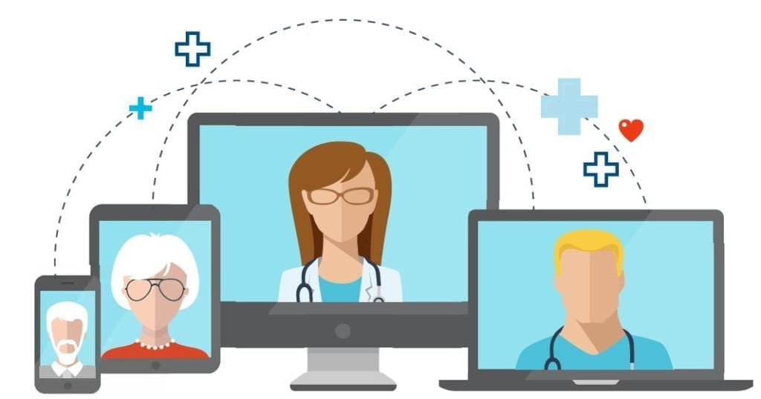
Telemedicine: Uses for an Elderly Population
Telemedicine allows for patients to access mental healthcare during isolation
Telemedicine opens the door for increased support
In clinical practice, I have witnessed patients who were reluctant to engage in therapy feel safer behind the screen

Slide 64
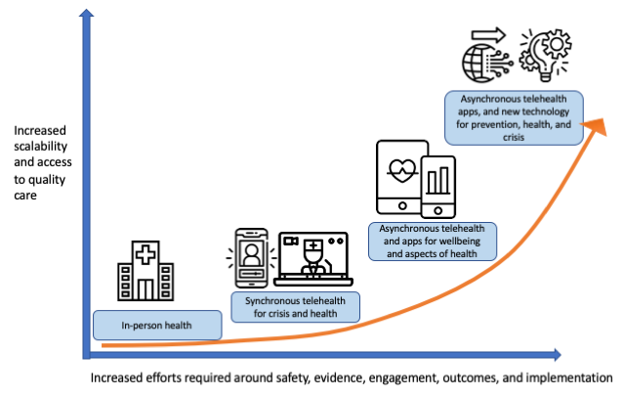
Further Advances
Currently, tele medicine is delivered typically in a one-on-one format
The need for asynchronous tele health is increasing
Incorporation of apps and organized digital asynchronous interventions will be key given the mental health burden caused by the pandemic

Slide 65
Telemedicine: Ethical Considerations
Check board requirements for licensure (state of license versus state of residence)
HIPPA compliant systems
Consent for new patients
Insurance Issues
Confidentiality
Psychology.ca.gov/licensees/hippa_telehealth.shtml
https://www.hhs.gov/hippa/for-professionals/faq/telehealth/index.html

Slide 66
The Impact on the Healthcare Worker
The well-being of the health care workforce is the cornerstone of every well-functioning health system. As a result of the pandemic, medical healthcare providers are under an enormous amount of workload pressure along with increased total health expenditures. The overwhelming burden of COVID-19 illness could lead to caregiver burnout

Slide 67
Healthcare Worker Impact
Experience from SARS and H1N1 epidemics underline that the psychological strain on healthcare professionals, who find themselves at the frontline of attempts to quell the outbreak, is significant
In the early rapid expansion phase of the SARS outbreak, similar to the current course of COVID-19 pandemic, healthcare professionals reported:
  Feelings of extreme vulnerability
  Uncertainty and threat to life
  Somatic and cognitive symptoms of anxiety
  Moderately high anxiety and subsequent psychological distress

Slide 68
Protecting Mental Healthcare Workers (HCWs) is Key
Available evidence (Greenberg, 2020) suggests that protecting healthcare workers requires consideration of six key elements:
1. HCWs should be appropriately thanked. Appropriate acknowledgement of the challenging work undertaken can foster resilience
2. Given that avoidance is a key symptom of traumatic stress and this behavior may manifest through distressed staff staying away from work, it is imperative that staff who do not turn up to work are contacted in case their non-attendance is indicative of poor mental health.

Slide 69
Continued
3. As the COVID-19 pandemic begins to recede all HCWs should receive ‘return to normal work’ interviews.
4. Managers should pay particular attention to HCWs in high-risk groups, junior or inexperienced staff who have been working above their expected level of competence.

Slide 70
Continued
5. Anyone who has been exposed to a potentially traumatic event should be actively monitored
6. Given the likelihood that HCWs have been exposed to morally distressing circumstances during the COVID-19 pandemic, most probably repeatedly, managers should help them to make sense of their experiences. Being able to develop meaningful narrative that does not blame themselves or others for what happened during the crisis is likely to reduce the risk of them suffering psychological harm.

Slide 71
Conclusions
The mental health care burden is great
The elderly are at especially high risk
Interruption of care must be noted
Methods of care delivery must be re assessed
Provider self care is key to manage the wave of cases coming

Slide 72
Q & A with Nicolle Ionascu

Slide 73
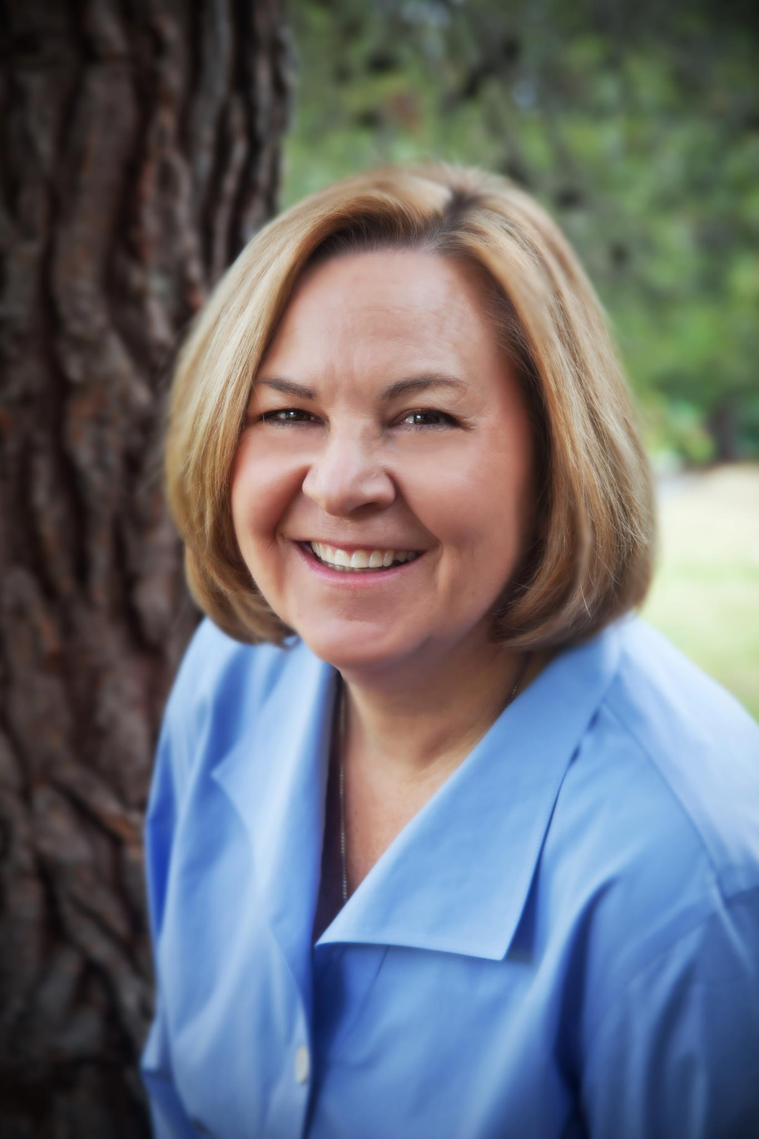
Pam Fenenbock M.Ed., Bereavement Counselor, L.M.F.T. (46644)
Mindfulness Moment
Pam Fenenbock is a licensed counselor trained in leading guided imagery, mindfulness, and relaxation exercises to help hospice patients and bereaved families with anxiety, stress and grief.

Slide 74

Relaxation Exercise

Slide 75

Goals Today
Introduction of using relaxation tools with Hospice patient and with ourselves
These tools can minimize pain and decrease anxiety and stress
This Photo by Unknown Author is licensed under CC BY

Slide 76

Two Dolphins Stress Test
Below is a picture of 2 dolphins
If you see 2 dolphins, your stress is at acceptable levels
If you see anything other than 2 dolphins, your stress is high!

Slide 77

If Your Stress is High
Have you ever felt like this?

Slide 78

Mindful Breathing
Self rating-1->10
Belly or Diaphragmatic Breathing
Stay in the present moment
Focus on sensation of inhale and exhale
“Park” or allow other thoughts to float away

Slide 79

Body Scan and / or Guided Imagery

Slide 80
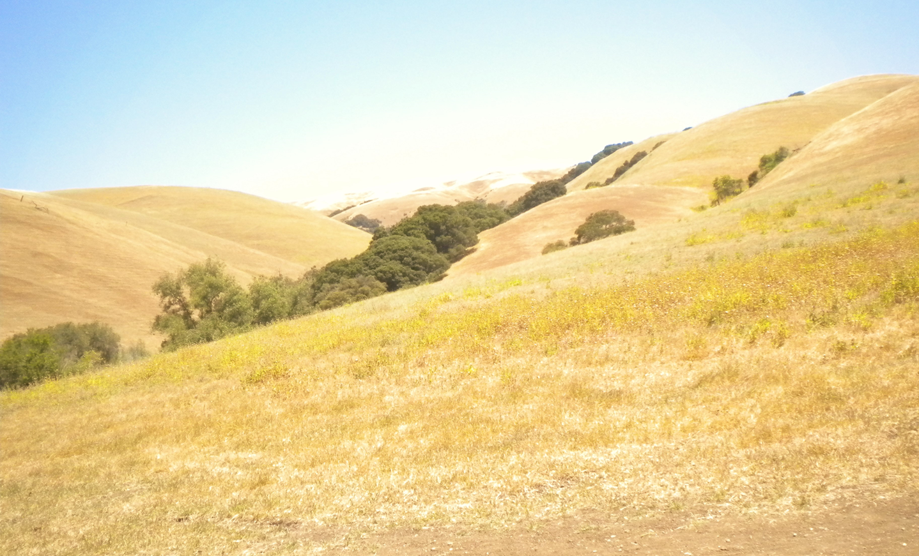
Even a Few Minutes a Day Helps

Slide 81
Micheal Pope
Welcome
Housekeeping items
Please remain logged in for full webinar
Please participate in polls and questions
Please remain muted
Please submit all questions through the Chat, each presenter will answer questions at the end of their presentation. We will have a Q & A with our Panel at the end of the day.
PowerPoint slides are available here:
https://eldercareanswers.Com/event/ouragingnation2020/
Please be sure to submit your completed evaluation which will be emailed at the end of the presentation today. Please email it back to sgunnett@homecareassistance.com
If your email address changes please email sgunnett@homecareassistance.com
For those who successfully watch, participate and submit their evaluation form, a certificate will be emailed to you. Please allow two weeks for e-mail delivery of your certificates

Slide 82
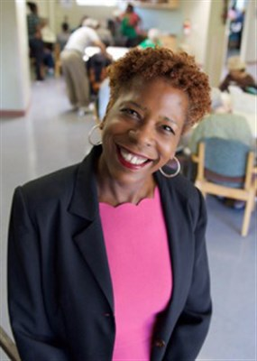
Third Speaker: Micheal Pope
11:30 AM: Where Do We Go From Here
Micheal Pope-CEO. Micheal Pope joined ASEB in 1997. She served as Program Director and Director of Development before becoming Executive Director in 2008. With a Bachelor’s degree in Marketing from New Hampshire College and course work in City Planning and Urban Affairs at Boston University, Micheal has more than 20 years’ experience in health care management, with an emphasis in marketing. She is a board member of the California Culture Change Coalition Steering Council and a past member of the Long Term Care Steering Committee and the Service Review Advisory Committee/East Bay Paratransit. She has served on the board of Ombudsman, Inc., Alameda, and is the past-president of the Board of the Contra Costa Child Care Council. In addition to her work at ASEB, she is Lay Leader at the Concord United Methodist Church. She also provides counseling and support to youth in foster care programs.
Micheal believes that everyone must contribute if change is to come about. Serving on the board and staff of ASEB is one of the greatest highlights of her life, an honor that brings meaning to her every day. Her two children, Milton and Jade, provide her with laughter, joy and growth from within. They are the source of her energy.

Slide 83
Where Do We Go From Here
Presented by Micheal Pope
CEO, ASEB

Slide 84

Unlikely Partners
Notes:
Racism is an essential factor to understand racial health disparities in infection and mortality due to COVID-19 and must be thoroughly integrated into any successful public health response. But highlighting the effect of racism generally does not go far enough toward understanding racial/ethnic health disparities or advocating for change; we must interrogate the various forms of racism in the United States, including behaviors and practices that are not recognized by many as racism.

Slide 85
Institutional Bias in Healthcare
“Black patients’ pain is routinely underrated and undertreated by clinicians,” said Uché Blackstock, MD, the founder of Advancing Health Equity, in a conversation with Forbes contributor Maryann Reid. “The under treatment of pain has significant deleterious consequences, such as lost wages, decline in mental and emotional health, self-medication with counterfeit medications and chronic stress. One of the promises in the Hippocratic Oath is ‘do no harm,’ however, clinicians have routinely caused black patients more harm by undertreating their pain.”

Slide 86
Demographic Profile of Different Racial Ideologies Among
White Americans (N=2530): Means and Percentages for Control
Variables of Respondents with More Racist than Antiracist Attitudes
Percent of sample | Old fashioned 25.3 | Institutional 52.5 | Symbolic 67.9 | Laissez-faire 63.2 | Color-blind 64.0
Age (mean) | 47.2 | 50.8 | 50.4 | 48.2 | 50.1
Education (% college degree) | 24.0 | 28.3 | 27.3 | 32.7 | 33.3
Evangelical protestant (%) | 17.3 | 21.0 | 20.5 | 17.8 | 18.8
Household income (mean) | $56,925 | $59,225 | $59,225 | $59,992 | $62,292
Male (%) | 50.1 | 50.4 | 48.8 | 48.5 | 50.1
Married (%) | 54.8 | 59.8 | 59.4 | 58.6 | 61.4
Democrat (%) | 22.3 | 16.4 | 17.8 | 25.1 | 19.9
Independent (%) | 34.4 | 34.3 | 35.1 | 35.5 | 34.2
Republican (%) | 38.9 | 46.0 | 43.6 | 35.5 | 42.7
Notes:
This profile highlights that those holding old-fashioned racist attitudes on average have a lower socioeconomic status in terms of education and household income than those exhibiting other types of racist attitudes. Conversely, those adopting color-blind racist attitudes tend to have a higher socioeconomic status than those who exhibit other types of racist attitudes. Across all types of racism, self-identified Republicans are much more likely to hold more racist attitudes than Democrats, with independents falling in the middle. Republicans are nearly three times as likely to adopt institutional racist attitudes, and more than two times likely to adopt symbolic and color-blind racist attitudes than their Democrat counterparts.

Slide 87
How Do Different Forms of Racism Shape COVID-19 Disparities?
Laissez-faire
Provider Attitudes
Institutional and Systemic
Symbolic
Notes:
Laissez-faire
Laissez-faire racism is the notion that blacks' cultural inferiority is to blame for the black–white gap in socioeconomic standing. Bobo and Smith argue that laissez-faire racism differs from symbolic racism in that it is rooted in a historical analysis of the changing economic politics of race.³¹ Laissez-faire racists do not feel that black people and other racial minorities are as capable as white people, especially in terms of employment because of the racial stereotypes they hold. Specifically, they feel that black people and other racial minorities should not be in positions that are thought to require intelligence, hard work, and composure or that provide racial minorities with power and responsibility over whites.
Negative attitudes toward certain social groups or personal characteristics often exist at the margins of awareness and are not easily accessible to individuals. Social psychology scholars have conceptualized prejudicial attitudes or bias as implicit and explicit.8 Explicit attitudes are thoughts and feelings that people deliberately think about and can make conscious reports about. On the other hand, implicit attitudes often exist outside of conscious awareness, and thus are difficult to consciously acknowledge and control. These attitudes are often automatically activated and can influence human behavior without conscious volition. Racial/ethnic bias in attitudes, such as feeling that White people are nicer than Black people, whether conscious or not, can lead to prejudicial behavior, such as providers taking more time with White patients than Black patients and therefore learning more about the White patients’ needs and concerns.
Institutional and systemic
Not all racism occurs on the individual level, as racist ideology has shaped the structure and operation of major social institutions in ways that limit opportunity and perpetuate racial inequality. Racial ideas and ideology shaped US law, and through historical and governmental processes, functioned to create and dominate various racial groups. For example, scholars point to real estate practices such as redlining, voting laws, and educational policies that limit economic, political, and social opportunity for nonwhite Americans coming into contact with these institutions. This form of racism is particularly insidious because it is difficult, if not impossible to pinpoint the individual prejudice or racial ideology that is responsible for discrimination. As a result, this type of racism is often invisible to those not affected by it, and through downplaying its existence, whites can perpetuate existing inequality.
Symbolic
Symbolic racism involves the belief that black people are themselves responsible for any disadvantages faced. This contemporary version of racism includes downplaying the existence of historic and systemic racism and instead focuses on black people's perceived lack of ability to succeed compared with other racial minorities. This belief system can help us understand why many Americans are resistant to policies that would ameliorate racial inequality, especially in terms of widespread health disparities.²⁸ For example, disparities exist in insurance rates by race in the United States, but policies such as the Affordable Care Act (ACA) were heavily criticized for providing social welfare benefits without addressing the individual behaviors that were at the heart of insurance disparities.²⁹ Lack of insurance is associated with poor health care access and the progression of chronic diseases that are primary risk factors for severe COVID-19 infection. Americans without health care coverage, who are disproportionately nonwhite, are not only at higher risk for infection from COVID-19, but also face considerable economic barriers if they need medical treatment in a hospital. The lack of support for policies to redress centuries of disparities in health care access is a direct result of racial stereotypes adopted within the framework of symbolic racism such as believing that black Americans themselves, rather than historic and persistent racism, are responsible for disadvantage.

Slide 88
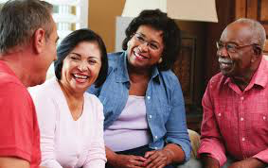
Color-blind Racism & Racial Apathy
assessment
judgement
diagnosis
careplanning
communication
Notes:
Color-blind racism and racial apathy
Color-blind racism refers to a new racial ideology rooted in apathy and disagreement with government policy, ensuring the fair treatment of racial minorities. Bonilla-Silva⁹ argues that through the emergence of color-blind racism, whites have developed powerful explanations for contemporary racial inequality that exculpate them from any responsibility for the status of people of color. Color-blind racism allows whites to maintain their advantages without having to articulate at whose expense. For example, whites who say, “I don‘t believe in giving black people access to health care—they should get it themselves but are too lazy to get a job” is thought to reflect a laissez-faire racist ideology, an older form of cultural racism. In contrast, whites who say, “I do not believe in giving black people access to health care because no one should get anything because of their race” could reflect a new form of modern or color-blind racism (adapted from affirmative action example given in Bonilla-Silva⁹).
Although the emphasis on cultural stereotypes epitomizes symbolic racism, a more covert, and perhaps insidious, form of racism operates among Americans who simply do not think that race any longer affects social, health, or economic outcomes. The result is racial apathy, or the feeling that race no longer is of consequence and as such the topic of racism can be avoided.¹⁰ Epidemiologists have uncovered patterns of premature aging or “weathering” among nonwhite Americans who experience subtle forms of interpersonal aggression by people who claim to not be acting with prejudice. This very type of chronic stress, however, has been linked to a vast array of illnesses, from premature labor to hypertension, and heart disease—all of which may exacerbate the severity of COVID-19 infection and mortality from the disease. In the context of COVID-19, unconscious or implicit bias likely shapes decisions for who gets medical treatments, especially when resources are scarce, such as being admitted to a hospital or receiving a ventilator. Other examples may extend to the receipt of personal protective equipment (PPE) for nonwhite medical professionals and essential workers or on who receives COVID-19 tests if presenting with symptoms. A teacher from New York is just one example of a black patient meeting the criteria for a test yet not receiving one until her illness had progressed to a point that it eventually killed her.³⁹

Slide 89

Conscious Bias and Unconscious Bias
Conscious Bias is Intentional
Unconscious Bias is Unintentional
Notes:
Conscious bias
When we are consciously bias we are doing it intentionally. We know we are being bias towards a particular person or group. Imagine you prefer working with men more than women. Or you don’t like working with young people or those with a different colour skin or culture. These are all dangerous prejudices. Most people now understand that there is no place for this in the modern workplace. Laws and policies exist to prevent prejudice based on race, age, gender, gender identity, physical abilities, religion, sexual orientation and many other characteristics. Should you act upon prejudices in the workplace you could face disciplinary action, lose your job and even be charged with a criminal
Unconscious bias can occur when we need to make decisions and judgements. We are not always making conscious decisions which are well thought through, taking all factors into account. Our brains work quickly so they access information which is known and familiar to us first. This information is based on our personal experiences meaning there is a natural bias towards views and opinions which fit with the world view we are most familiar and comfortable with. By doing this unconsciously, there is no malicious intent, we are often unaware that we have done it, and of its impact and implications.
Unconscious bias clouds and undermines decisions. Unconscious bias holds on to stereotypes and will disregard anyone who fits into these groups.
A great unconscious bias example is how google reacted when youtube launched their video upload feature. They were confused by 5-10% of the videos being uploaded upside down. Why would so many people be shooting their videos incorrectly? The answer was simple and highlighted the designers assumptions. Some people were filming videos with their left hands. As the individuals who designed the feature were right handed they made an assumption that everyone is right handed and their way was ‘correct’. They did not consider that left handed users would rotate the screen causing it to appear upside down. This is unconscious bias.

Slide 90
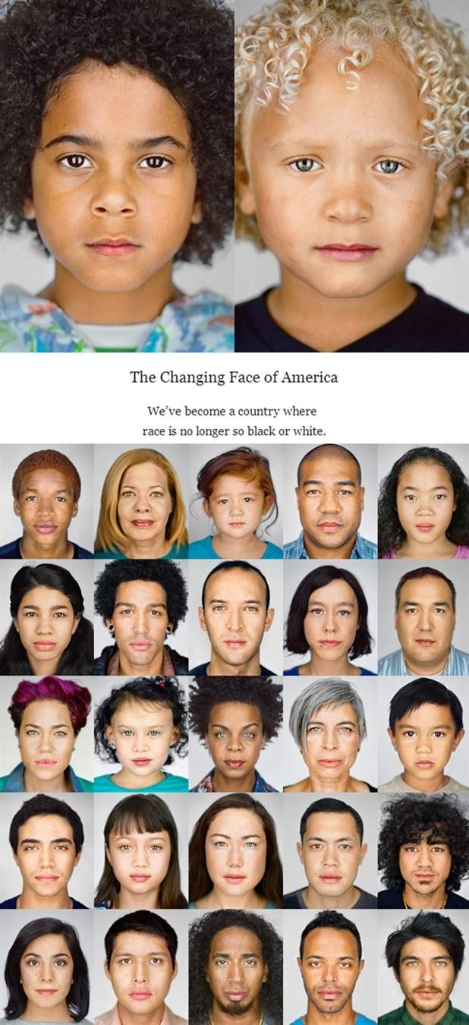

Slide 91
Overcoming Bias
Get out of denial
Ask: What am I doing …
that might prevent this person from seeking care?
prevent this person from trusting me?
Be present with your feelings
Let silence do the heavy lifting
Go deeper

Slide 92

Communication
Do I have the full picture?
What am I feeling?
What do I see?

Slide 93
Organizational Structures
Create credibility with your patients
Oppression within the structure must be addressed
Tokenism is a common pitfall
Be realistic and honest
Be open

Slide 94
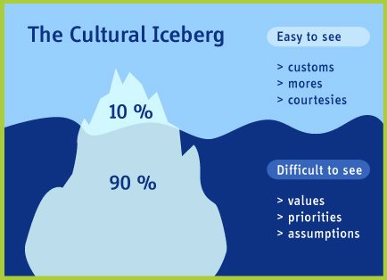
The 90%

Slide 95
Next Steps
implicit.harvard.edu.
Become Allies
Educate yourself
Check your inner circle. Who is in it? Why? Who’s missing? Who is your default? What are your reactions to these questions? Why?

Slide 96
Q & A with Micheal Pope

Slide 97
Q & A Our Aging Nation Panel

Slide 98
Thank You
PowerPoint slides are available here: https://eldercareanswers.com/event/ouragingnation2020/
Please be sure we have the correct. e-mail address for you. Notify Sandi. Gunnett if your email address changes.
Please be sure to submit your completed evaluation, which will be emailed at the end of the presentation today, to sgunnett@homecareassistance.com
For those who successfully participate and submit their evaluation form please allow two weeks for e-mail delivery of your certificates
At the successful completion, participation and, submission of evaluation a certificate will be emailed to you within two weeks

