Slide 1
Clinical Evaluation of Capacity In Cognitively Compromised Adults
Eric J. Freitag, Psy.D., FACPN
Board Certified in Neuropsychology
Executive Director, Mt. Diablo Memory Center

Slide 2
No disclosures or conflicts of interest to declare.

Slide 3
Objectives
How to recognize when a client may have diminished legal capacity
Brief review of different types of capacity and how they are evaluated
Brief review of driving capacity

Slide 4
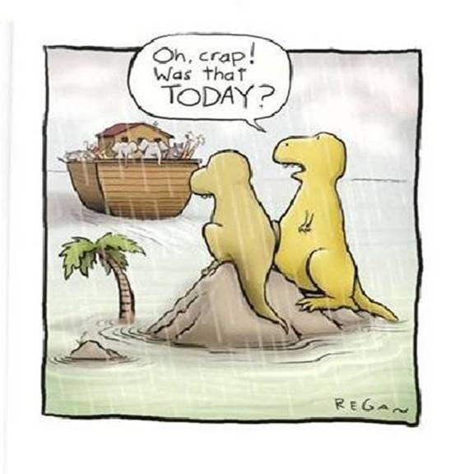

Slide 5
Statement of the Problem
From 2000-2011, 18% Increase in population >65 y.o
Population of older adults will nearly double in the next 30 years
Approximately 30% of households will expect a transfer of wealth from a passing family member
1 in 9 seniors report being financially abused within the last year

Slide 6
Capacity Issues
Capacity is not a unitary construct
Capacity of individual can be variable
Common referral question: “Does client/patient have capacity?”
Capacity evaluation is often not medically necessary and therefore cannot be billed to insurance

Slide 7
Recognizing Diminished Capacity
Cognition = Conscious mental activities
  Understanding
  Learning
  Thinking
  Remembering
Probate Codes: Section 6100.5, 810-813

Slide 8
Subtle Signs of Impairment
Insight and Awareness
  Anosognosia (“Lack of awareness”)
  Do you have memory problems?
Poor Adaptive Functioning
  Awareness of date, location, self, and purpose of appointment/meeting
  Can they fill out office forms independently?
  “When does the evaluation start?”
    Office staff observations

Slide 9
Subtle Signs of Impairment
Poor Historian
  Accuracy of autobiographical recall
    Occupation, children, important family relationships
  Consider interviewing client separately from family
  Correlate family information with client report
Memory Loss
  Can client identify the date? (level of inaccuracy)
  Can client discuss recent events? (news, recent trips, books read)
  Draw family tree
Comprehension and reasoning
  Follow questioning
  Is client tangential or circumstantial?

Slide 10
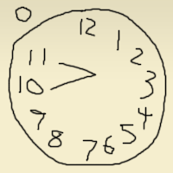
Measuring Cognitive Impairment
Evaluate short term and semantic memory
  5 word recall after 5 minutes
    0-2: probable memory impairment
  Current president
  Orientation (date, purpose, self)
Abstraction
  How are a dog and a lion alike?
  How are a banana and orange alike?
Gross impairment
  Clock drawing (10 after 11)
  Impairment = Pathognomonic

Slide 11
Measuring Cognitive Impairment
Performance on activities may help differentiate between moderate and severe impairment
Caution is warranted
Are primary sensory deficits impacting capacity?
Are there ways that capacity can be improved?
  Larger print forms
  Scheduling
  Meeting client in own home
  Is client ill or recovering from illness

Slide 12
Types of Capacity
Financial
Driving
Independent Living
Testamentary
Legal
  Real Property, Contract, DPOA
Medical Care
Consent to sexual relationship
Consent to marry
Consent to participate in research

Slide 13
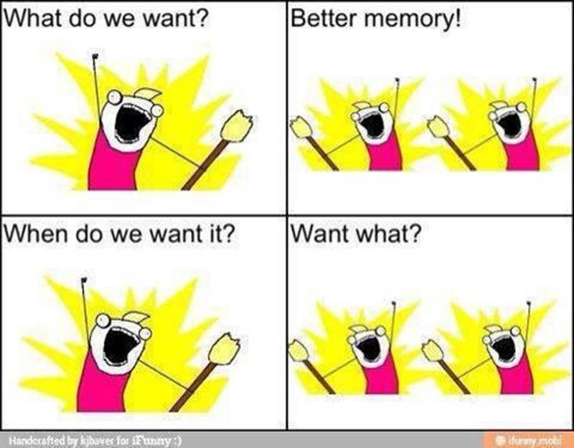
Clinical Evaluation of Capacity

Slide 14
Clinical Evaluation of Capacity
Define the referral question
  Capacity in question must be specific
  Have episodic or transitory causes of potential decline in capacity been addressed?
Brief vs. thorough cognitive testing
Review of general health and medications

Slide 15
Clinical Evaluation of Capacity
Semi-Structured and Structured Interview that is broad and specific to the capacity in question
  e.g. “Semi-Structured Interview of Testamentary Capacity”
Testing measures specific to referral question
Opinion based on accumulation of data and reasonable medical certainty
No single test or piece of data determines capacity

Slide 16
General Questions In Capacity Assessment
Understand the nature of the choices
Appreciate the consequences
Formulate rational understanding about the situation
Understand the situation and other options

Slide 17
Clinical Referral Information
Types of Practitioners
Psychiatrist (forensic)
  Medical doctor (MD or DO)
  Training and experience related to mental health and the law
Psychologist (forensic)
  Ph.D. or Psy.D.
  Similar, and in many cases more extensive, training and experience regarding mental health interventions, consultation and treatment
  In California, not able to prescribe medication

Slide 18
Clinical Referral Information
Types of Practitioners
Neuropsychologist
  Licensed psychologist (Ph.D. or Psy.D.)
  Specific expertise, training and experience in the understanding of brain-related disorders and their impact on behavior
  Title is not regulated by state licensing board
  Qualifications:
    Pre-doctoral internship
    2-year post-doctoral fellowship
    Membership in neuropsychology-related societies and organizations
    Demonstrated continuing education in the field
    Board certification (ABN or ABCN)

Slide 19
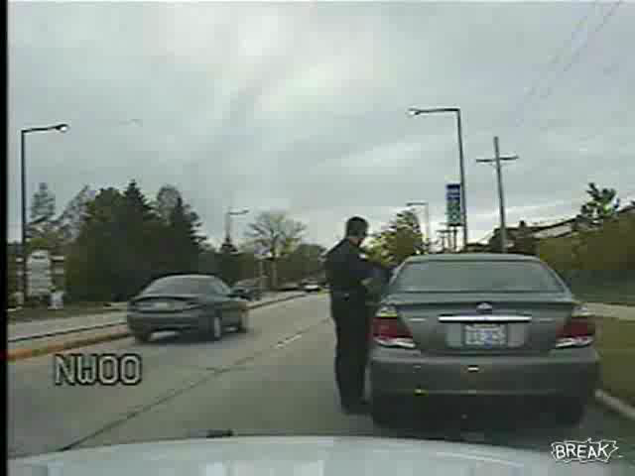
Houston, We Have A Problem!
Notes:
Once the driver leaves the clinicians office, is there really a risk that the driver will perform a dangerous activity on the road…absolutely!
The problems typically do not occur under normal circumstances in a familiar environment with no challenges. The cognitively impaired driver when faced with a challenging or frustrating situation may lack the ability to properly react due to slower mental processing, lack of ability to focus or disengage, or simply mental confusion.
This video gives a very real and enhanced example of what can happen. The driver is cognitively loaded, combative and frustrated and clearly lacks the ability to properly deal with the situation.
Once video runs or during video running it helps to mention that the officer has called for an ambulance, the driver still has his foot on the gas pedal (sparks and revving noise) and the officer is asking him to turn off the car, clearly cannot disengage due to the cognitive load of the situation.

Slide 20
Driving Capacity
Defining The Problem
Number of older adult drivers will double in the next 20 years
Confusion regarding reporting laws
Families may identify driving risk but are unsure about how to go about taking away car
Limited options for fair and objective testing

Slide 21
Signs of At-Risk Driver
Decline in ability to perform everyday tasks
Memory loss
Decline in physical functioning
Lack of awareness of driving errors
Close calls
Drives too slowly
Misses traffic signs
Gets lost
Confuses brake and gas pedals
Frequently gets honked at by other drivers

Slide 22
Signs of At-Risk Driver
Questions to ask family(usually the adult child)
  Would you allow your child to ride with your parent?
If the answer is no, it is time to start the process of taking away the keys.

Slide 23
Driving Assessment
Traditional cognitive assessment has limited predictive validity in evaluating driving risk
MMSE or other in-office physician-based screening of cognition even less effective

Slide 24
Driving Assessment
My Approach To Assessment
  Review medication and health conditions
  Brief test of common driving laws and rules
  Cognitive screening
  Administration of DriveABLE
    Evidence-based, computerized assessment

Slide 25
Case Examples
93 year old female, moderate dementia, assisted living
No immediate family, moderate estate
Local niece served as POA for several years
Client/niece’s attorney notified by out-of-town nephew’s attorney of intent of client to change POA
Brief neuropsychological and capacity assessment
  Moderate to severe cognitive deficits
  Difficulty identifying family members
  No insight into self care needs (e.g. would wear soiled underwear)
  Could not explain purpose or consequence of a DPOA

Slide 26
82 year old male, diagnosed with MCI, living well independently
Repeated victimization
  3x Nigerian $ Scam,1x grandparent scam
  Approx $100k total losses
Client knew enough to try to hide victimization
Neuropsychological assessment: mild to moderate memory impairment, normal executive functioning
Passed formal financial capacity battery except “credit card statement”
Outcome – with family intervention, client relented to allow daughters to execute financial DPOA

Slide 27
Slides and Handouts can be found online at www.EldercareAnswers.com/event/OurAgingNation2017
Up next: Why Hospice, Why Now by Cindy Hatton and Susan Levitt

