Slide 1
DISASTER PREPAREDNESS
Preparing YOU to Better Prepare THEM!
Mateika Martin, MHA, EMT
Emergency Preparedness Training Coordinator
Contra Costa County EMS Agency

Slide 2
OBJECTIVES
Discuss
Demonstrate the difference between societal expectations on caregivers and reality when attending to a client/patient in a disaster
Identify & Establish
Identify & establish the best disaster plan that suits you and YOUR family
Teach
Teach how to implement the “Help me Help you” concept
Demonstrate
Discuss the affects disasters have had and still have on “our aging nation”

Slide 3
“Disasters are devastating natural, accidental, or willful events that suddenly result in severe negative economic and social consequences for the populations they affect, often including physical injury, loss of life, property damage and loss, physical and emotional hardship, destruction of physical infrastructure, and failure of administrative and operational systems”
~ Homeland Security Affairs

Slide 4
At Risk & Most Vulnerable Population
Elderly population
Ages 65 years and older
By year 2020,
Expected to double in size
Bay area: 50% to 150% growth
Notes:
According to the California department of aging the elderly population is expected to grow more than twice as fast as the total population.
Within the Bay Area that growth will be between 50% and 150% by the year 2020

Slide 5
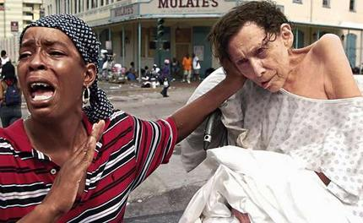
Past Incidents
Hurricane Katrina (2008)
Estimated 445k people displaced
Elderly first and most to die within 1st year
40% were over the age 70
Never returned to their pre-disaster condition
15% of people over age 60 were not accounted for after storm
75% of bodies found were elderly

Slide 6
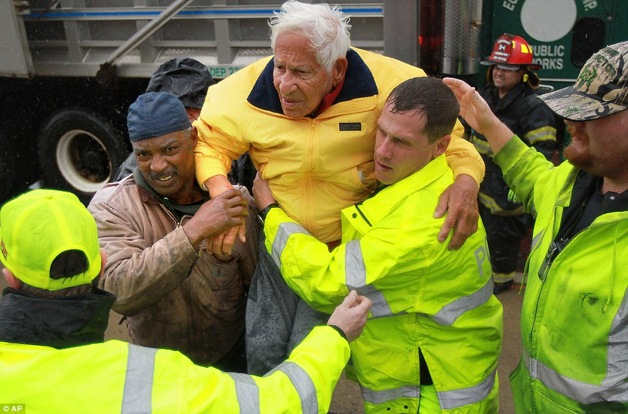
Past Incidents Cont.
Hurricane Sandy (2012)
Death toll ~150 people
Caribbean (67); Haiti (54); New York (42); New Jersey (12)
Maryland, Pennsylvania, West Virginia, Virginia, Connecticut, North Carolina
½ of those who died were 65 years and older

Slide 7
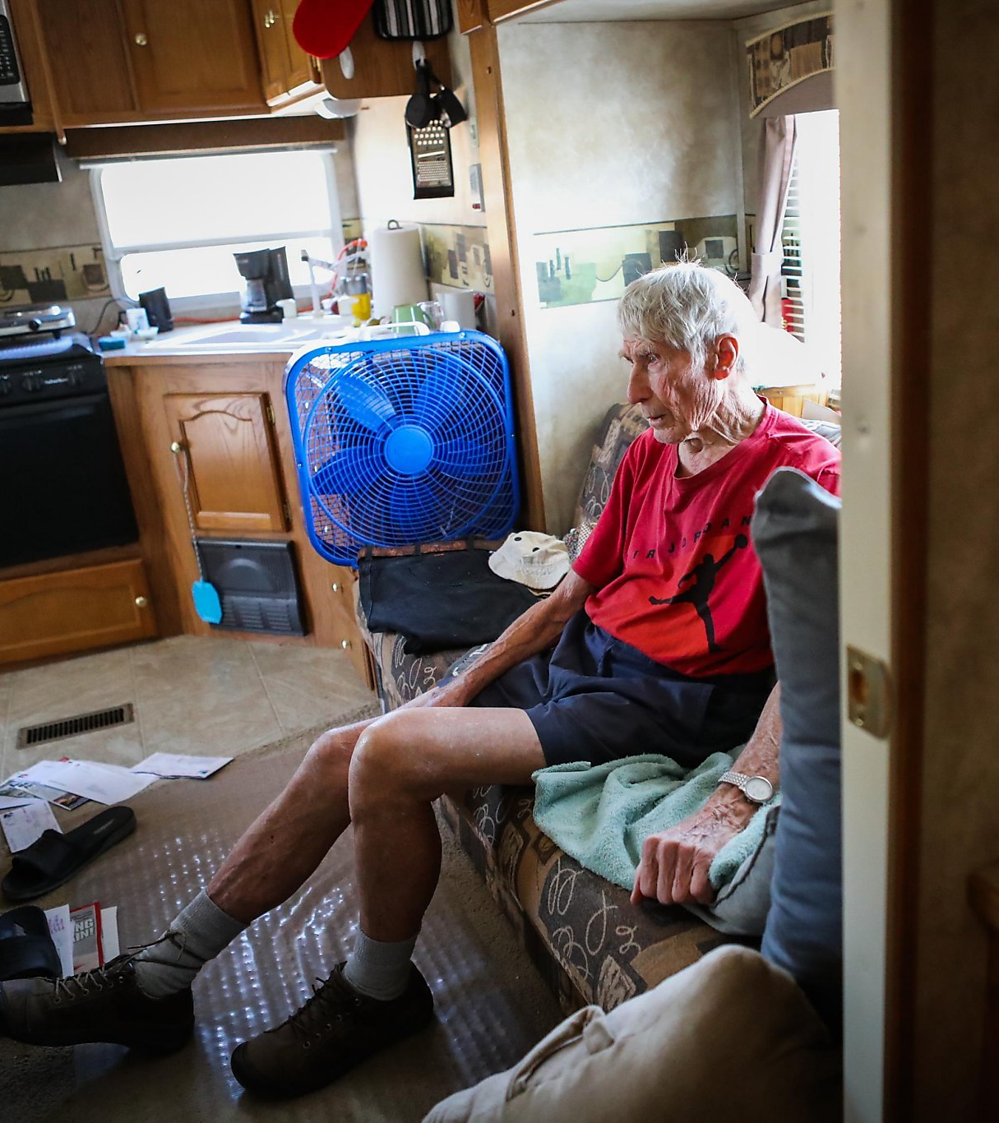
Past Incidents Cont.
Lake County Valley Fire (2015)
4 fatalities & 1300 homes burned
Returned victims lived in motorhomes, trailers, tents, etc.
More than 20k people displaced
Most did not have time to retrieve any personal items
Identified general population shelters for evacuees are not ideal, especially the elderly

Slide 8
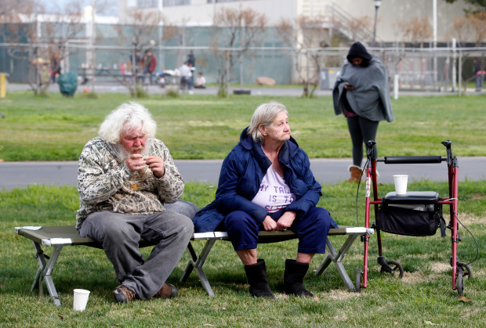
Recent Incidents
Oroville Dam Evacuation (2017)
One of California’s largest man-made lakes
One of the tallest dams in the nation
188k people evacuated
No estimated time residents will be able to return back to their homes
Major impacts on facilities servicing the elderly

Slide 9
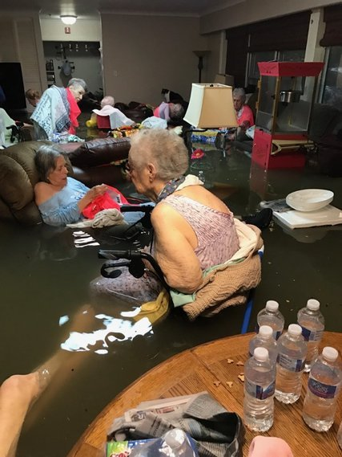
Recent Incidents Cont.
Hurricane Harvey (2017)
84 Fatalities
30k sheltered
2k hotels in 33 states accommodated 21k households
La Vita Bella Nursing Home
Informed relatives of rising water Sunday
Emergency responders: “Stay Put”
Ken Clark, Galveston County Commissioner
“Social media was not what brought emergency responders to the scene…a solution was already being worked on and in progress. Social media can leave the wrong impression…”

Slide 10
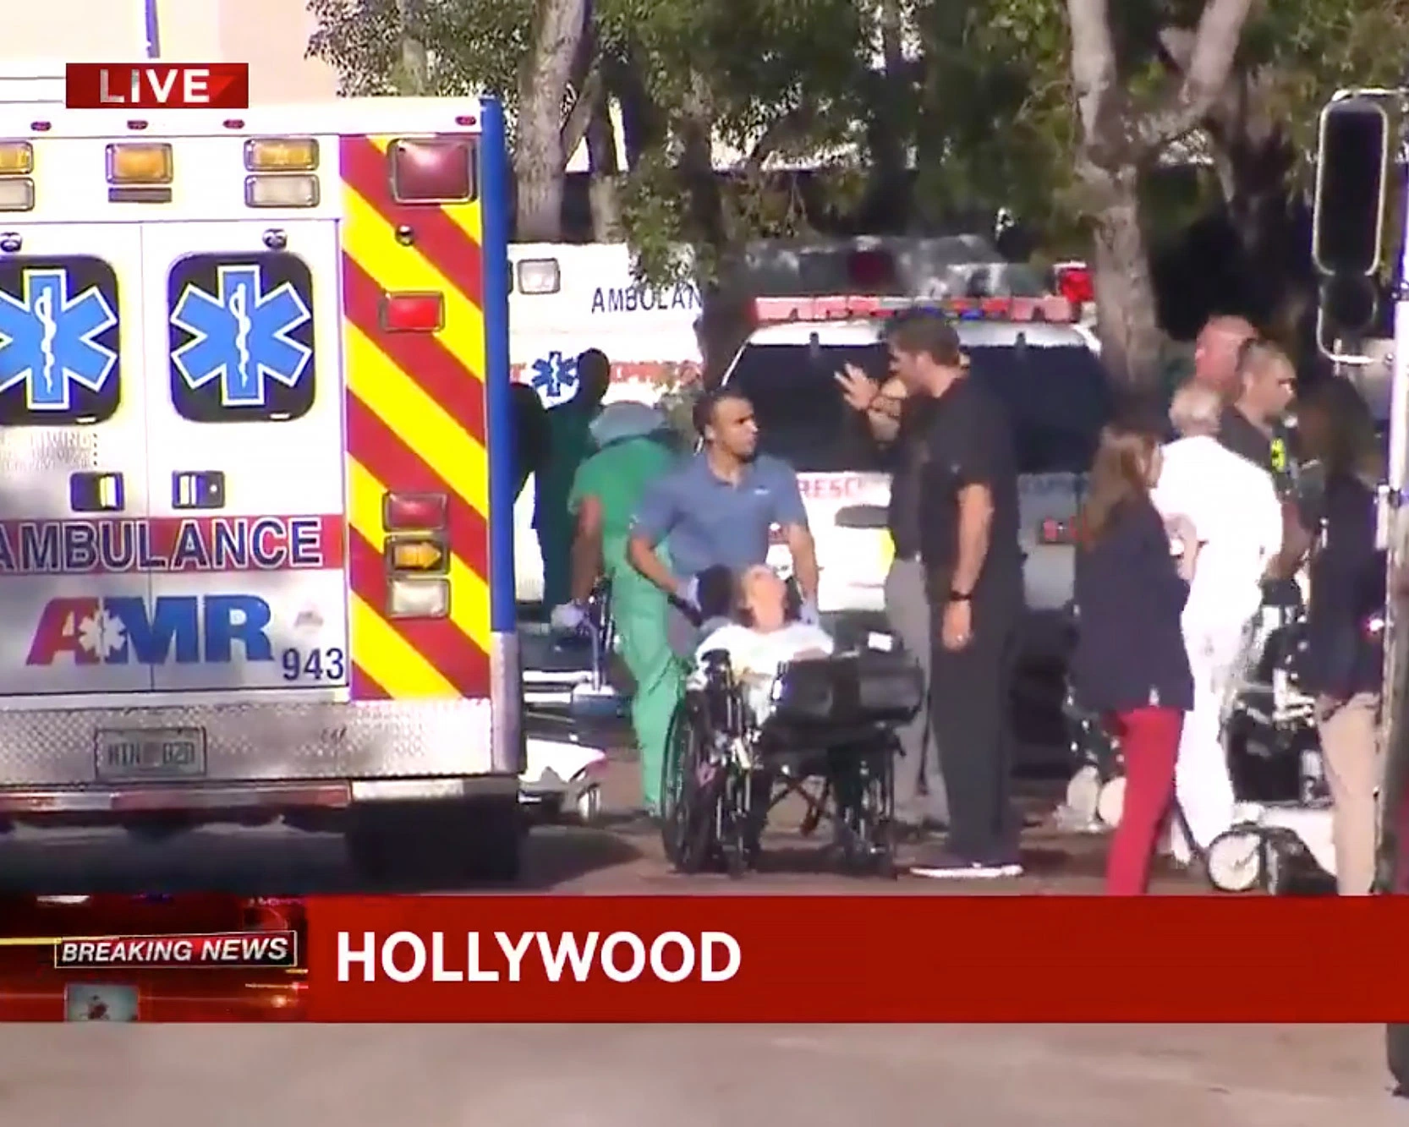
Recent Incidents Cont.
Hurricane Irma, 2017
Most powerful in Atlantic hurricane history
102 deaths
77k people in 450 shelters
The Rehabilitation Center of Hollywood Hills
12 deaths total: 8 initial, 3 after
Prolonged power outage
No good communication to family
Criminal Investigation ongoing
Notes:
Eight patients died Sept. 13, three days after the storm knocked out the nursing home's air conditioning. Others died in the following days. Some who died had body temperatures as high as 109.9 degrees Fahrenheit.
Investigators want to know why the patients died after the storm even though a fully functioning hospital sits just across the street from the nursing home

Slide 11
Causes & Long Term Aftermath
Vulnerability increased because of poverty & isolation
Elderly who live alone tend to lack transportation options to evacuate
Tend to live in the most dangerous places (beach, flood zones, etc.)
Inadequate care once evacuated and replaced
Many return to ongoing ruin, displacement, and hardship
Notes:
Reluctant to seek services or ask for family/friend for help from the desire to maintain their independence
Retirement low-income risk to live near environmental hazardous areas because it is cheaper

Slide 12
Normal Human Initial Response Unplanned vs Planned
Delay/Denial/D-n-D (disaster in a disaster)
Resisting fear & groupthink
Making the executive decision to respond
Preplanning must have taken place
Be scared…then let it go!

Slide 13
Expectations of Caregivers In a Disaster
Societal Expectations
No room for “Human Error”
The movie “Sully”
Medical decision made during Katrina
Notes:
The Miracle on the Hudson, Flight 1549 January 15, 2009

Slide 14
Reality Check!
Same lessons learned are identified over and over, incident after incident, but nothing is done
Communication systems fail
Command and control structures are fractured
Resources are slow to be deployed

Slide 15
Take Care of You FIRST
Plan, prepare, and train yourself and your families
Every plan will be personalized and tailored
Single vs Family
Children & Pets
Disabilities & Medical Conditions
Exercise & test the plan
Adjust your plan after every exercise or real event
What didn’t work?

Slide 16
“Help Me Help You”
Ultimate Goal:
Help clients know how to fend for themselves
Provide disaster resources, contacts, and training opportunities to assist in plan development
Encourage clients to test their plain
Repetition is KEY…Just keep repeating!
Empower clients to reach out to neighbors/family/community to include in disaster plan

Slide 17
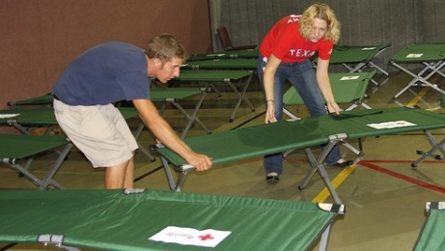
Reach out, Train, Exercise
Connecting with external partners
Med Health Coalition
Partnership with EP contact
(i.e. county, city, businesses, etc.)
Train & Exercise with them
Membership reflects Leadership
Be consistent and reliable
Takes a team!

Slide 18
Oldies but Goodies
“If you fail to plan, you are planning to fail.”
~ Benjamin Franklin
“Those who fail to learn from the past are doomed to repeat it.”
~ Sir Winston Churchill

Slide 19
Thank You!
Email: Mateika.Martin@hsd.cccounty.us
Phone: #925-768-9155

