Slide 1
Why Hospice? Why Now?
Cindy Hatton President & CEO
Susan Levitt V.P. Clinical Services/COO

Slide 2
Setting the Stage
Life expectancy in 1900 = 40 years
Life expectancy in 2000 = 80 years
1900: People died of infectious diseases
2000: People died of degenerative diseases
During the last 50+ years, medicine has become increasingly capable of postponing death

Slide 3
By 2030, 1 in 5 U.S. citizens will be 65 or older
In 1988, 30M were 65+
In 2011 (33 years later), 40M were 65+
In 2019 (just 8 years later), 50M will be 65+
By 2020, the population size of people 85 years of age or older is projected to be 7M, doubling to 14M by 2040

Slide 4
In 2014, 2.6 million people died in the U.S.
2.1 million (8 out of 10) had Medicare, making Medicare the largest insurer of end-of-life medical care
More than half (55%) were age 80 or older
Medicare spending in the last year of life = 25% of total Medicare spending for ages 65+

Slide 5
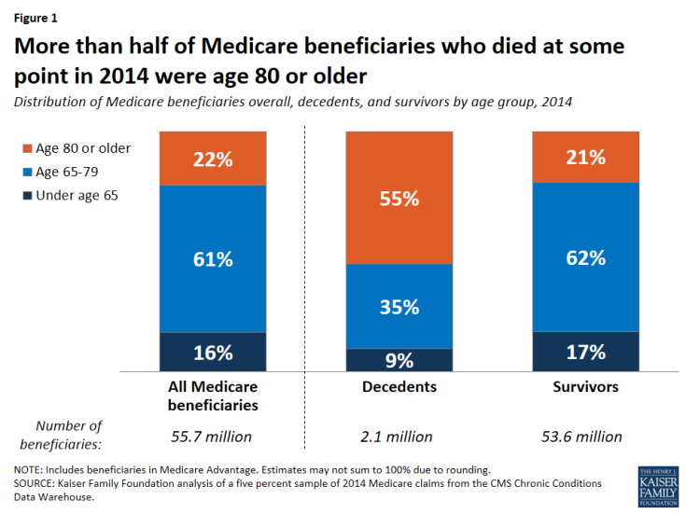

Slide 6
Disease Burden of Decedents (2014)
Hypertension (67%)
Ischemic heart disease (53%)
Chronic kidney disease (51%)
Congestive heart failure (48%)
Alzheimer’s disease or dementia (43%)
Diabetes (38%)
Cancer (17%)

Slide 7
It is predicted that by 2020, the number of people living with at least one
chronic illness will increase to 157 million.
Today, 7 out of 10 Americans die from
chronic disease.
68% of all Medicare costs are related to patients with four or more chronic conditions

Slide 8
Impact on Medicare
Higher Medicare per capita spending among decedents than survivors is primarily driven by much higher spending on inpatient hospital services
The share of per capita spending on inpatient hospital services for decedents accounted for just over half (51%) of total spending in 2014

Slide 9
Did you know?
Nearly 50% of all Americans die in a hospital
70% die in a facility: hospital, skilled nursing or long-term facility
Almost 1/3 see 10 or more physicians in the last 6 months of life
Yet when asked, 70% of all patients say they want to die at home

Slide 10
Iceberg?
Aging nation
Living longer with chronic illnesses
Increased healthcare demand
Increased healthcare cost

Slide 11
How Hospice & Palliative Care Can Help to Navigate the Waters

Slide 12
Types of Care
Curative Care
Focuses on curing an illness and prolonging life
Palliative Care
Focuses on comfort and quality of life and may be provided while still pursuing curative treatment
Hospice Care
Focuses on comfort and quality of life when a cure is no longer possible – provides specialized care and services

Slide 13
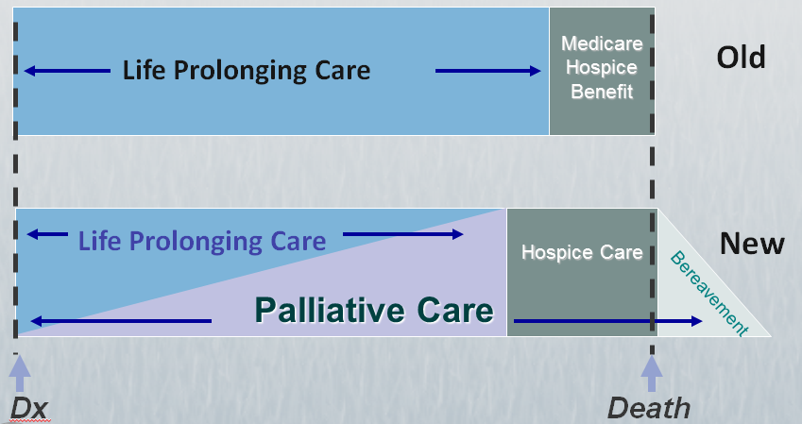
The Changing Paradigm

Slide 14
Public health takes a population health approach,
which places a greater emphasis on community health
including:
The population as a whole
The role of the community
Health promotion and preventative care, and
The need to involve a range of professionals

Slide 15
The Scope of Palliative Care
Care management for patients facing chronic or quality-of-life-limiting illnesses
Focuses on relief of symptoms, pain and stress
Can be provided along with curative treatment
Services covered: MD, NP, RN, Social Worker, Spiritual Care Counselor
Payment for coverage determined by health plan – not covered by Medicare
Patients’ primary MD must be available for needed orders

Slide 16
The Scope of Hospice Care
Serves patients with a 6 month or less life expectancy who are no longer receiving curative treatments for their illness
Supports family members throughout the process, as well as bereavement support after the patient’s death
Services covered: Hospice MD, NP, Social Worker, Nurse, Spiritual Care Counselor, Aide, Bereavement, 24/7 On-Call Nurse support, Durable Medical Equipment, Supplies and Medications related to the Hospice prognosis (diagnosis)
Medicare, Medi-Cal and most private insurance plans cover at 100%
Can be provided wherever the patient lives, whether in own home or in a facility

Slide 17
The Benefits of Palliative Care & Hospice
Patients receiving early palliative care:
Experienced less depression
Had better quality of life
Survived 2.7 months longer
Focus is on patient choice – understanding what a patient knows and what they need or want to know in order to make good decisions

Slide 18
The Benefits of Palliative Care & Hospice
The average cost of a 3-day hospital stay is around $30,000*
Average cost of a Hospice Day=Medicare paid an average of $153 per day
*healthcare.gov

Slide 19
Outcomes
Patient Choice
Advanced Directives
Improved pain and symptom management
Family/community involvement
Continuity of Care
Financial

Slide 20
Thank you!
Questions?

Slide 21
Slides and Handouts can be found online at www.EldercareAnswers.com/event/OurAgingNation2017 Up next: New Natural Strategies for Bone Health by Kathy Napoli

